Slide 1



Slide 2
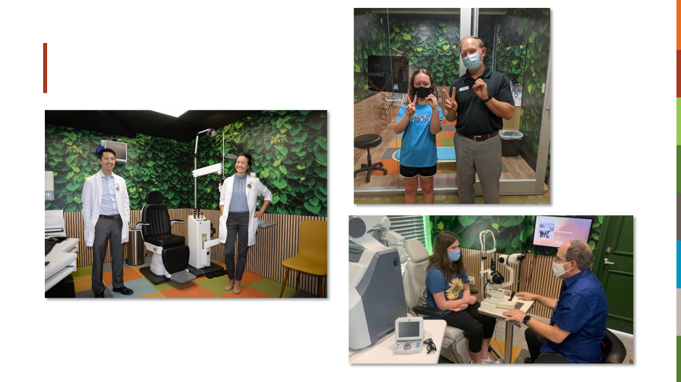

Slide 3
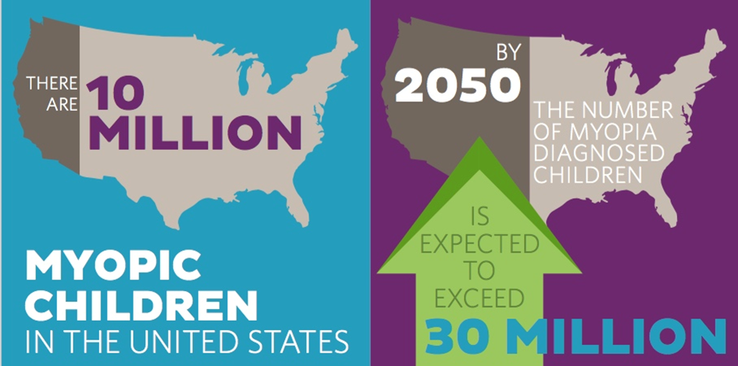


Slide 4




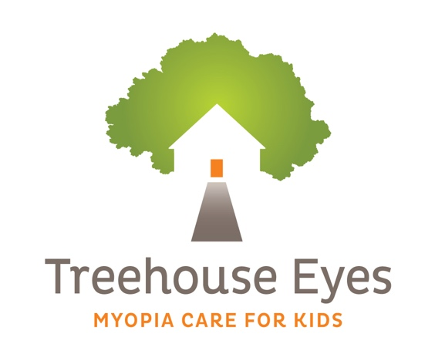
In April 2021, the World Council of Optometry passed a resolution that declares support for myopia management as standard of care¹
Treehouse Eyes Start Date Month/Year
Evidence-based standard of care combines three main components:
MITIGATION
MEASUREMENT
MANAGEMENT
1. World Council of Optometry. Resolution: The standard of care for Myopia Management by Optometrists. https://worldcouncilofoptometry.info/resolution-the-standard-of-care-for-myopia-management-by-optometrists. Accessed 2nd March 2022.

Slide 5
COVID Myopia looking at 123,535 children 1.4x to 3x WORSE
 | 2015-2019 average | 2020 after quarantine
6 Year Olds | 5.7% | 21.5%
7 Year Olds | 16.2% | 26.2%
8 Year Olds | 27.7% | 37.7%
Progression of Myopia in School-Aged Children After COVID-19 Home Confinement
Jiaxing Wang, MD, PhD¹; Ying Li, MD, PhD¹; David C. Musch, PhD, MPH²; et al
Nan Wei, MD³; Xiaoli Qi, MD³; Gang Ding, MD³; Xue Li, MD³; Jing Li, MD³; Linlin Song, MD³; Ying Zhang, MD³; Yuxian Ning, MD³; Xiaoyu Zeng, MD³; Ning Hua, MD³; Shuo Li, MD, PhD⁴; Xuehan Qian, MD, PhD³
Author Affiliations Article Information
JAMA Ophthalmol. 2021;139(3):293-300. doi:10.1001/jamaophthalmol.2020.6239

Slide 6
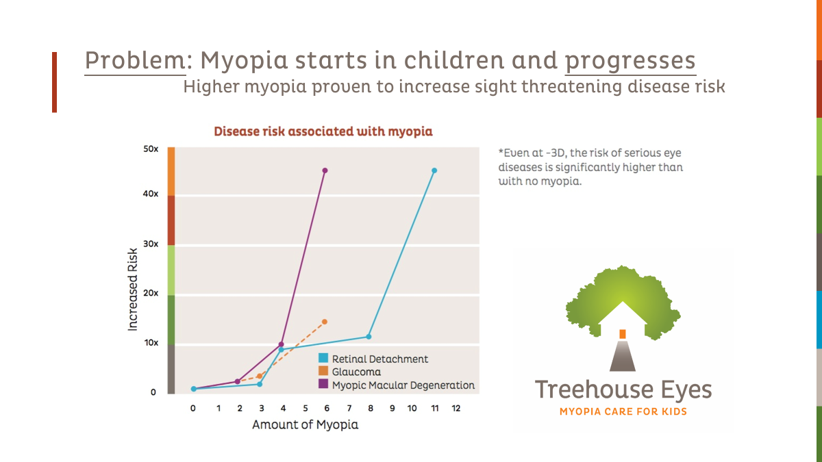

Slide 7
For every 1 Diopter of myopia progression reduced, we can reduce the risk of myopic maculopathy by 40%
Bullimore MA, Brennan NA. Myopia Control: Why Each Diopter Matters. Optom Vis Sci. 2019 Jun;96(6):463-465. doi: 10.1097/OPX.0000000000001367. PMID: 31116165.

Slide 8
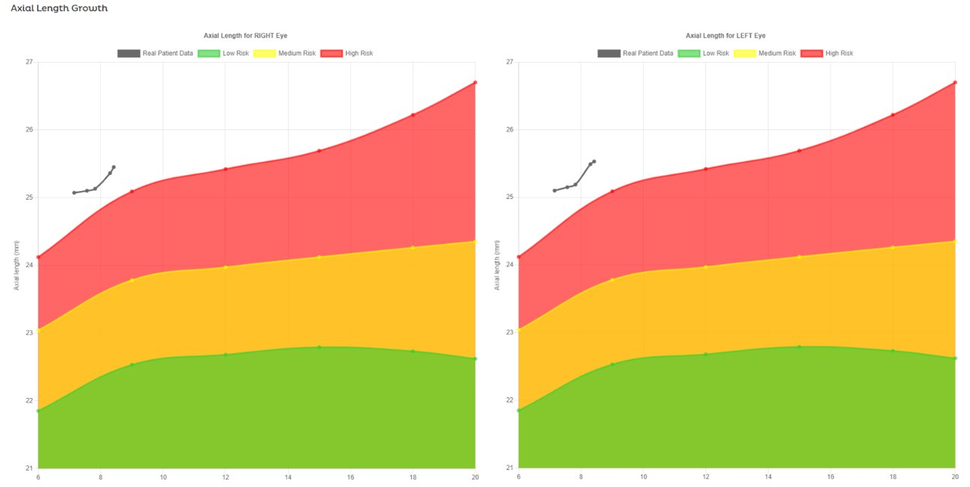
Eyes are Supposed to Grow
Emmetropes: 0.20 mm slowing to 0.10 mm per year

Slide 9
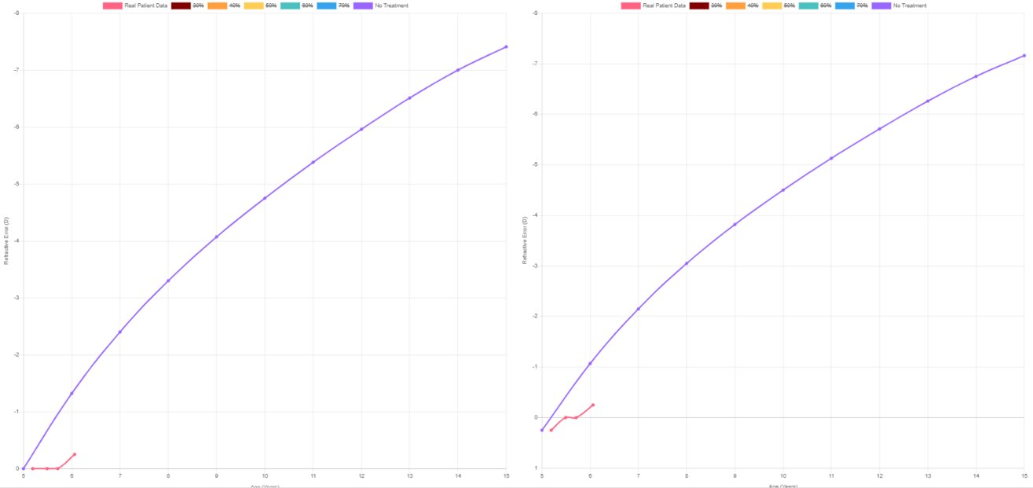
Refractive error projection of an emmetropic 5 year old (purple) vs real patient data treated with atropine

Slide 10
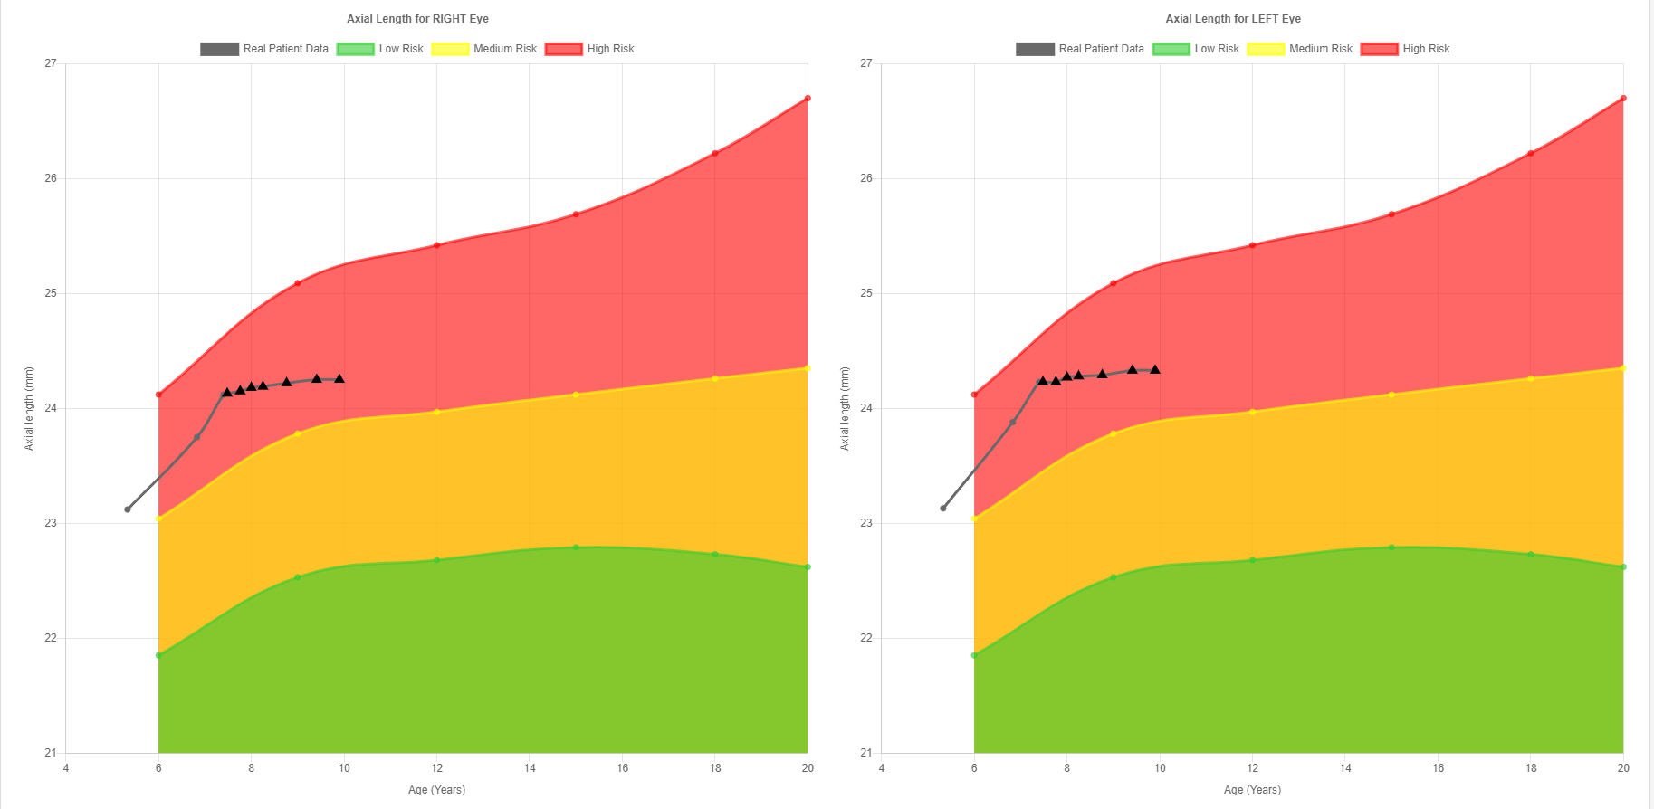
Example of a child who refused Tx for 2 years and progressed. Triangles represent AXL stability with treatment

Slide 11
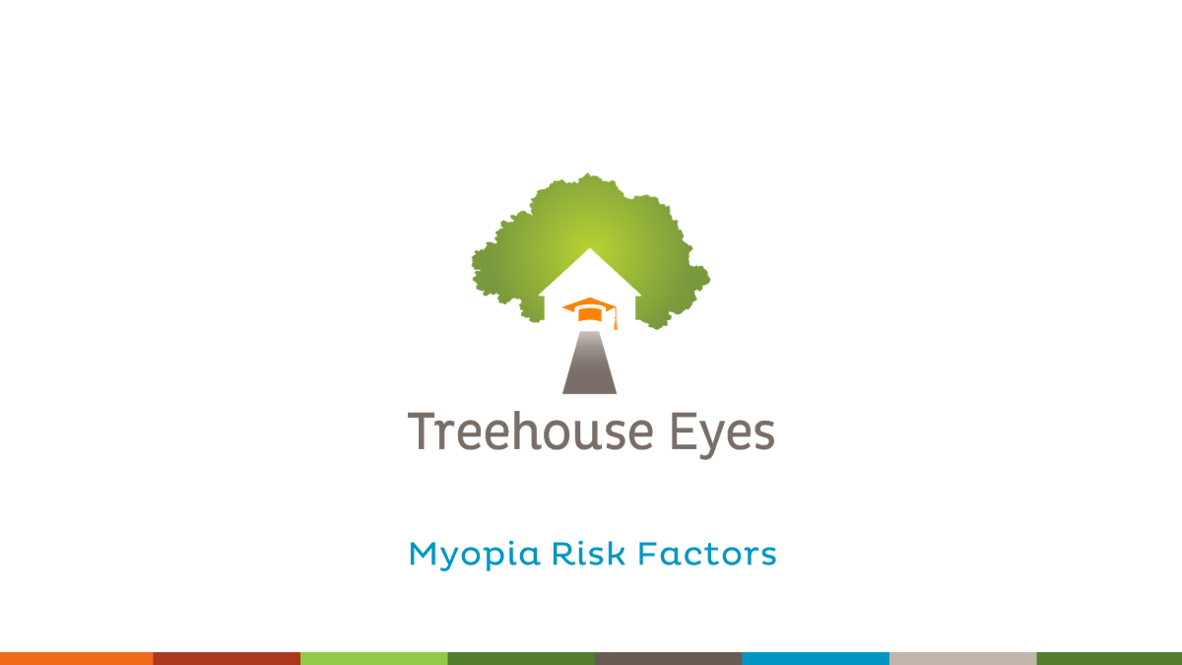
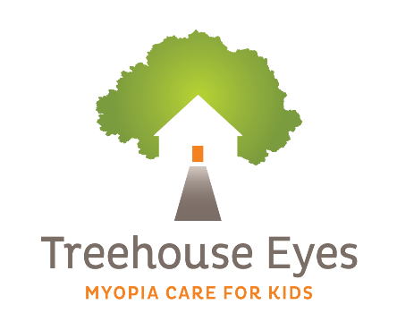
Myopia Risk Factors

Slide 12
Myopia Suspects (like GLC!)–Prediction of Juvenile Onset CLEERE study
4512 non-myopia kids
Evaluated 13 risk factors and found refractive error very predictive
6 year olds | 7-8 Year Olds | 9-10 Year olds | 11 Year
+0.75 | +0.50 | +0.25 | 0.00

Slide 13


What's causing all this myopia?
The classic Nature Argument
    Myopia in both parents = 35%
    Myopia in one parent = 25%
    No myopic parents = < 10%
    Females more myopic than males

Slide 14
“70% of today’s myopia is environmentally driven. 30% is genetic.”
FedOpto Medillian Columbia 2015
Dr. Monica Jong, Brien Holden Vision Institute
[
[
]
Lack of outdoor time
Near demand (?)

Slide 15
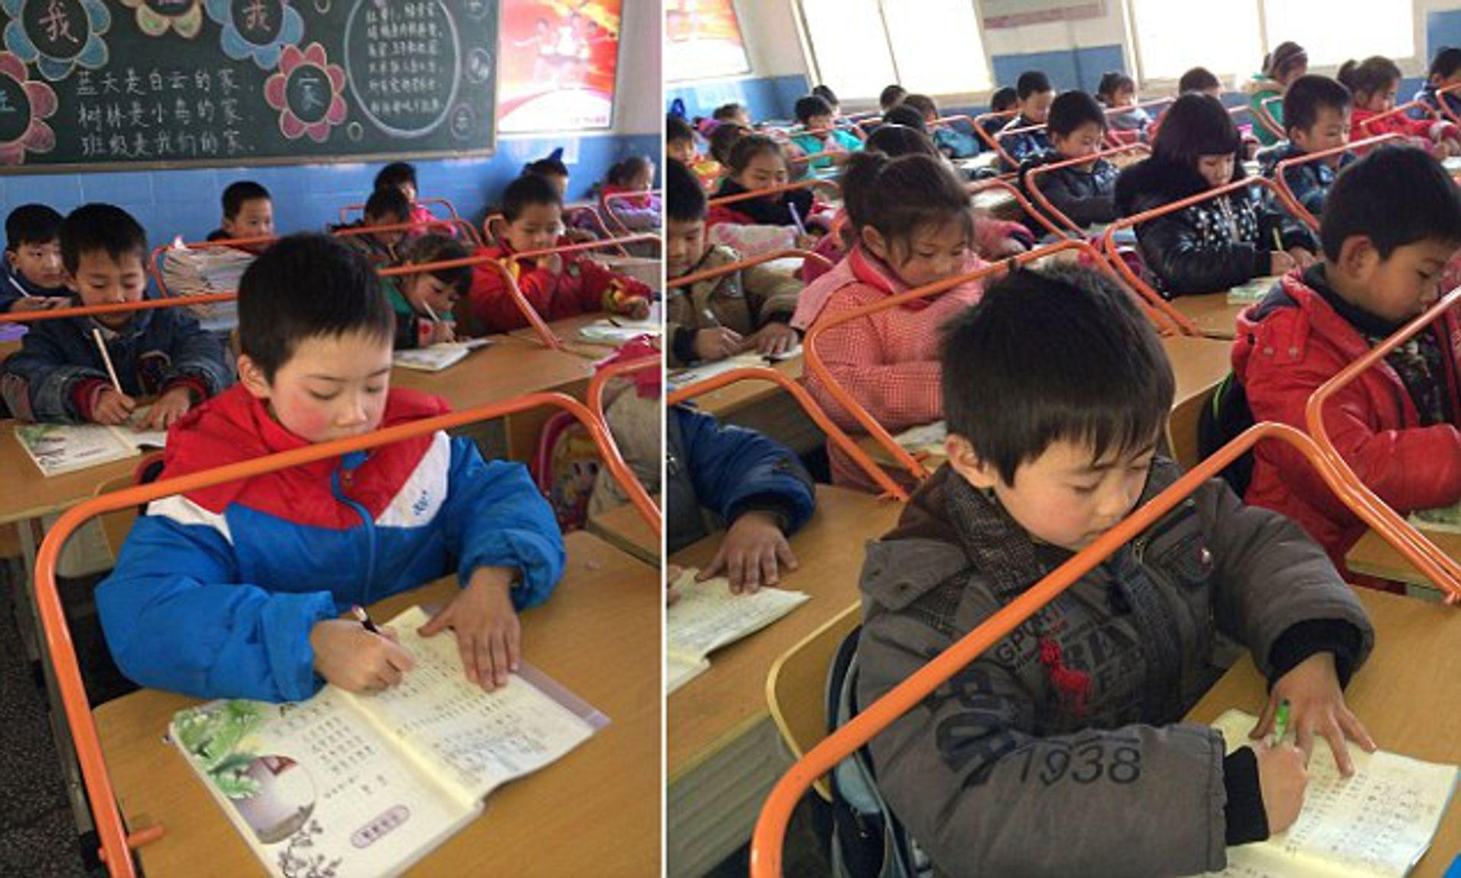

Slide 16
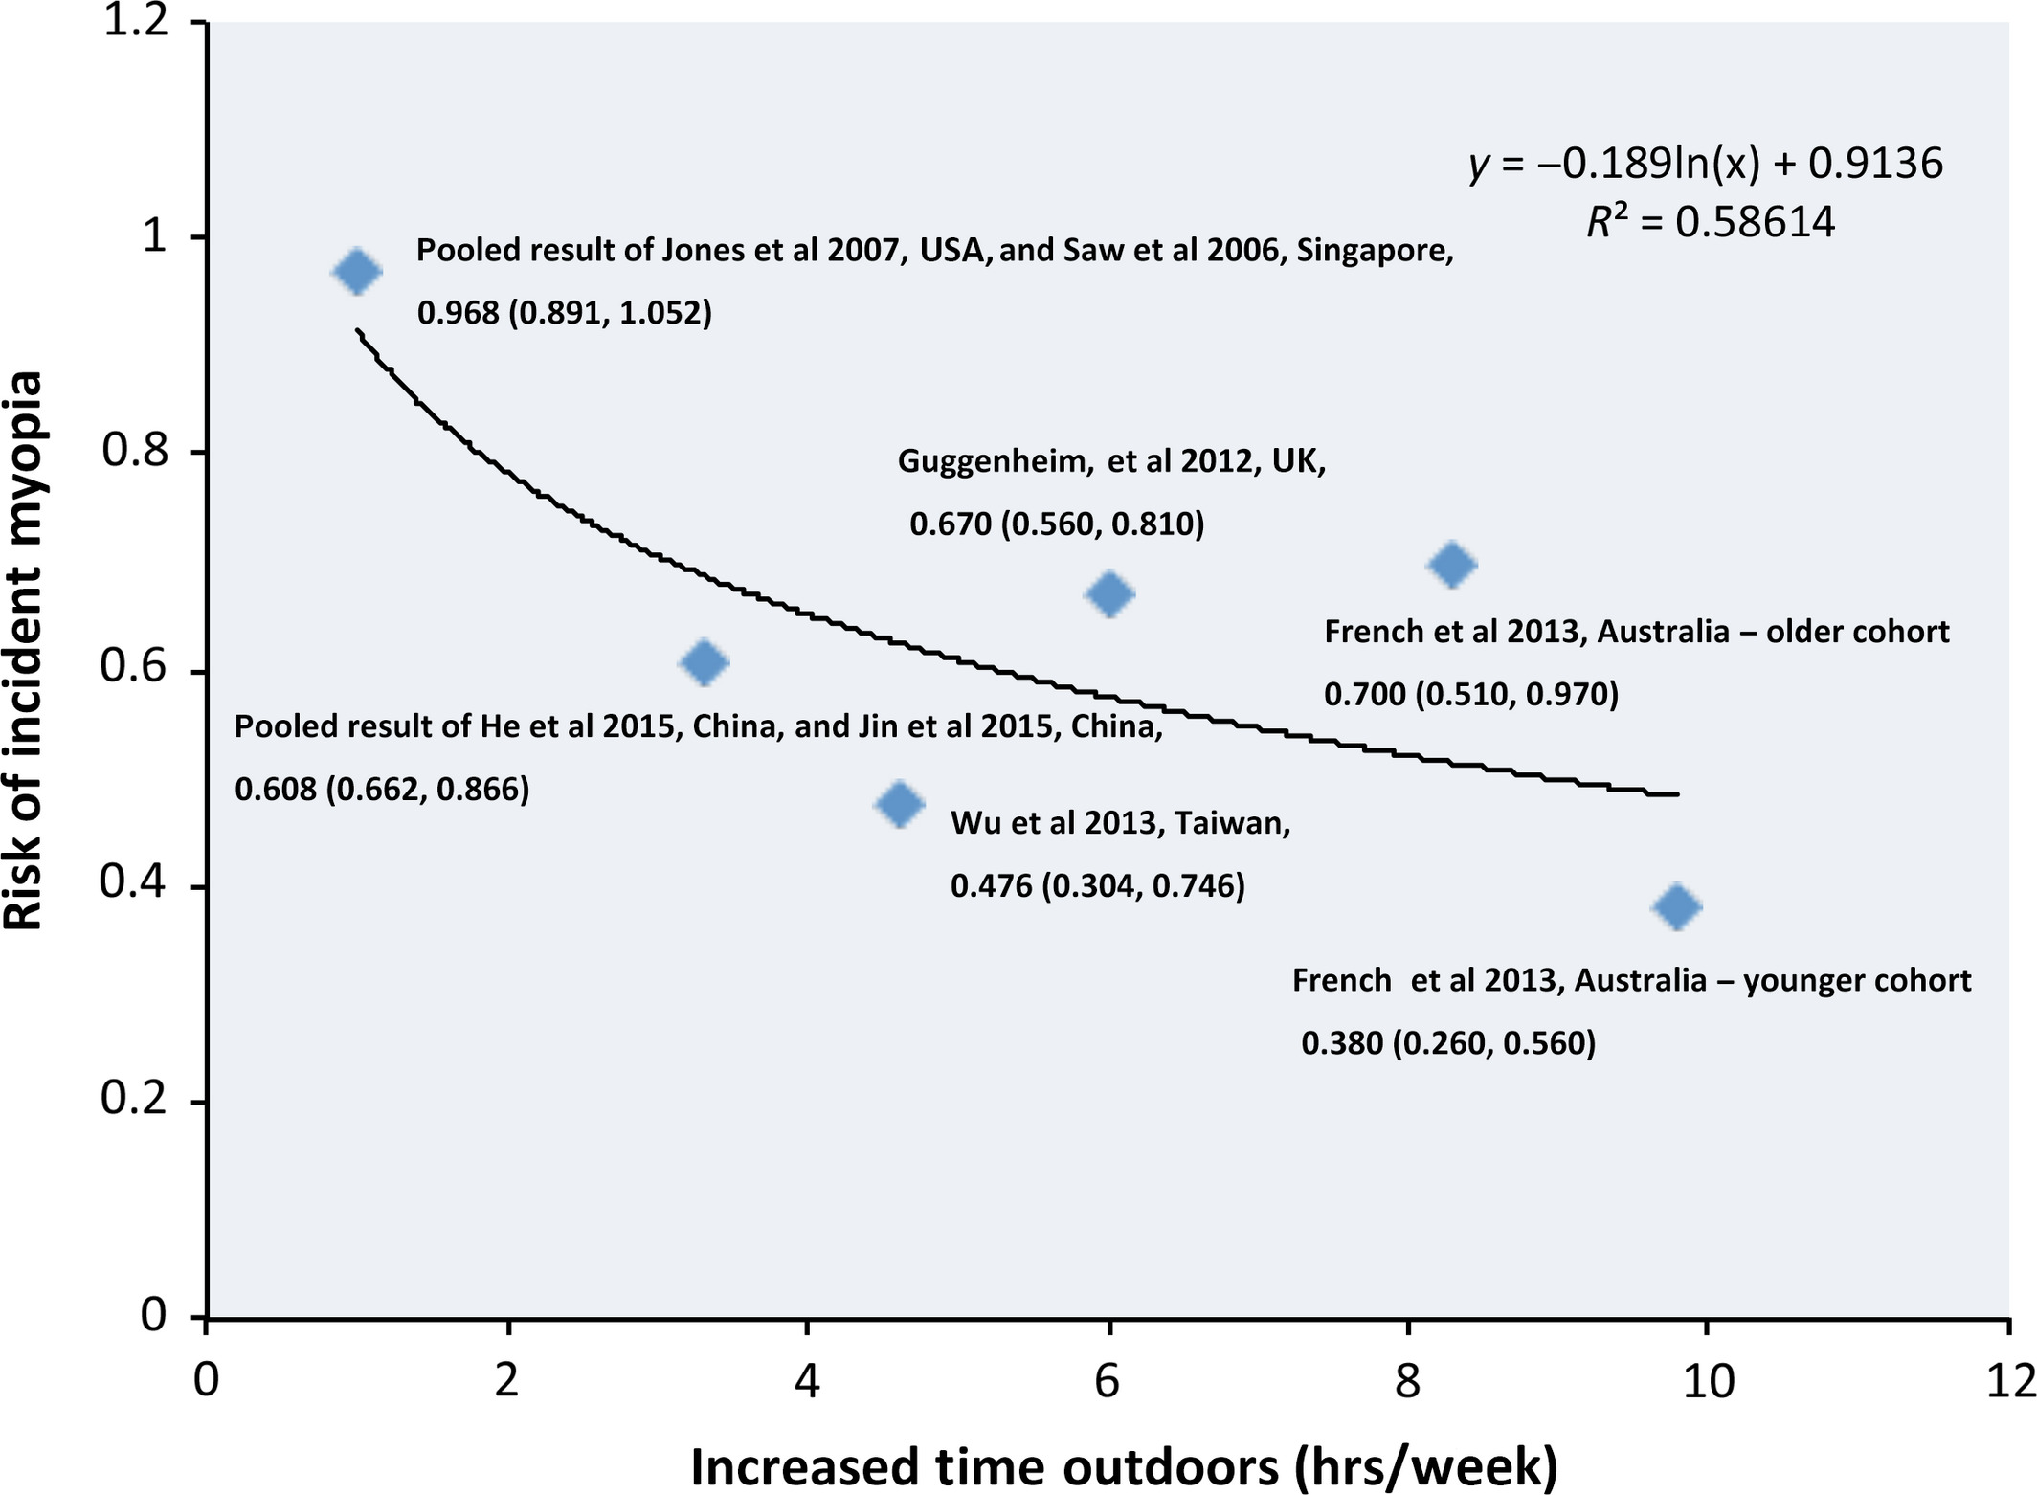
Outdoor Activities
The more the better!
~2% reduction in risk/hr/wk

Slide 17
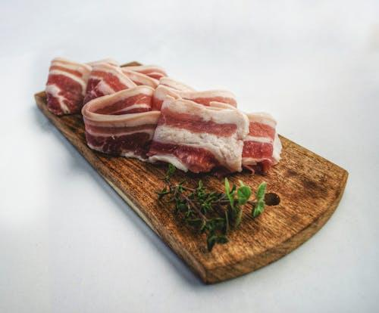
What about Diet?
What:
  851 children, 653 had myopia, average age 12.
  Followed for 3 years
What they found….
  Axial length was longest in highest quartile group of total cholesterol compared to lowest (0.34mm delta)
  Longest in highest quartile group of saturated fat intake vs lowest (0.29mm difference)
Conclusion: Higher saturated fats and cholesterol intake are associated with longer axial length in otherwise healthy children
https://doi.org/10.1016/j.ophtha.2009.10.003

Slide 18

When parents ask about screentime . . .
The World Health Organization recommends <1 hour of sedentary screen time for children
In the United States, a sample of 40,337 children 2-17 years of age was assessed
Found that use of screens (4 hours/day) to be associated with lower psychological well-being, including less curiosity, lower self-control, more distractibility, more difficulties in making friends, less emotional stability, being more difficult to care for, and inability to finish tasks.

Slide 19
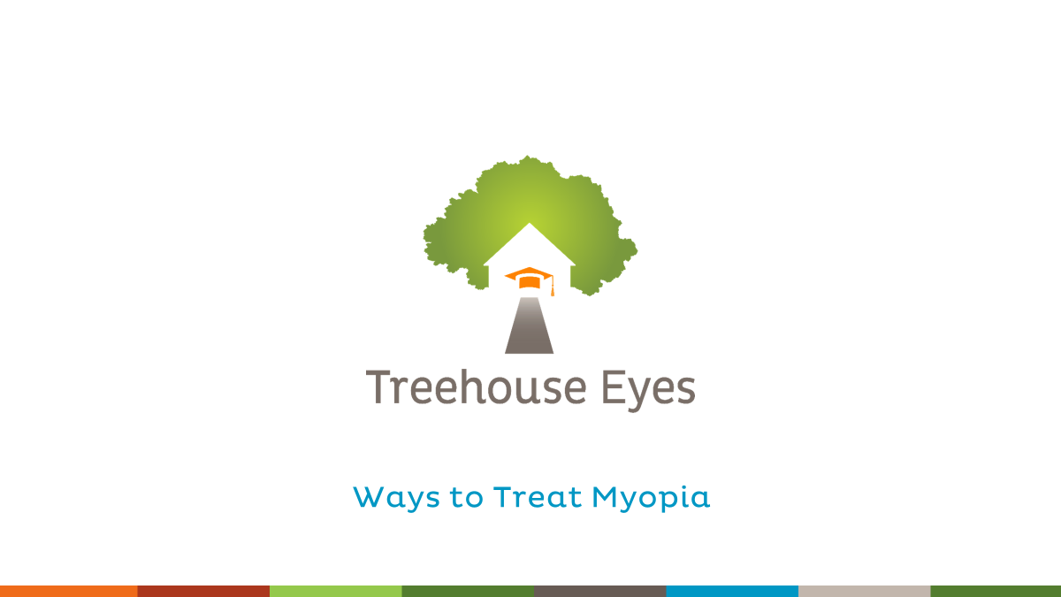

Slide 20
Questions
Spectacle Treatments

Slide 21
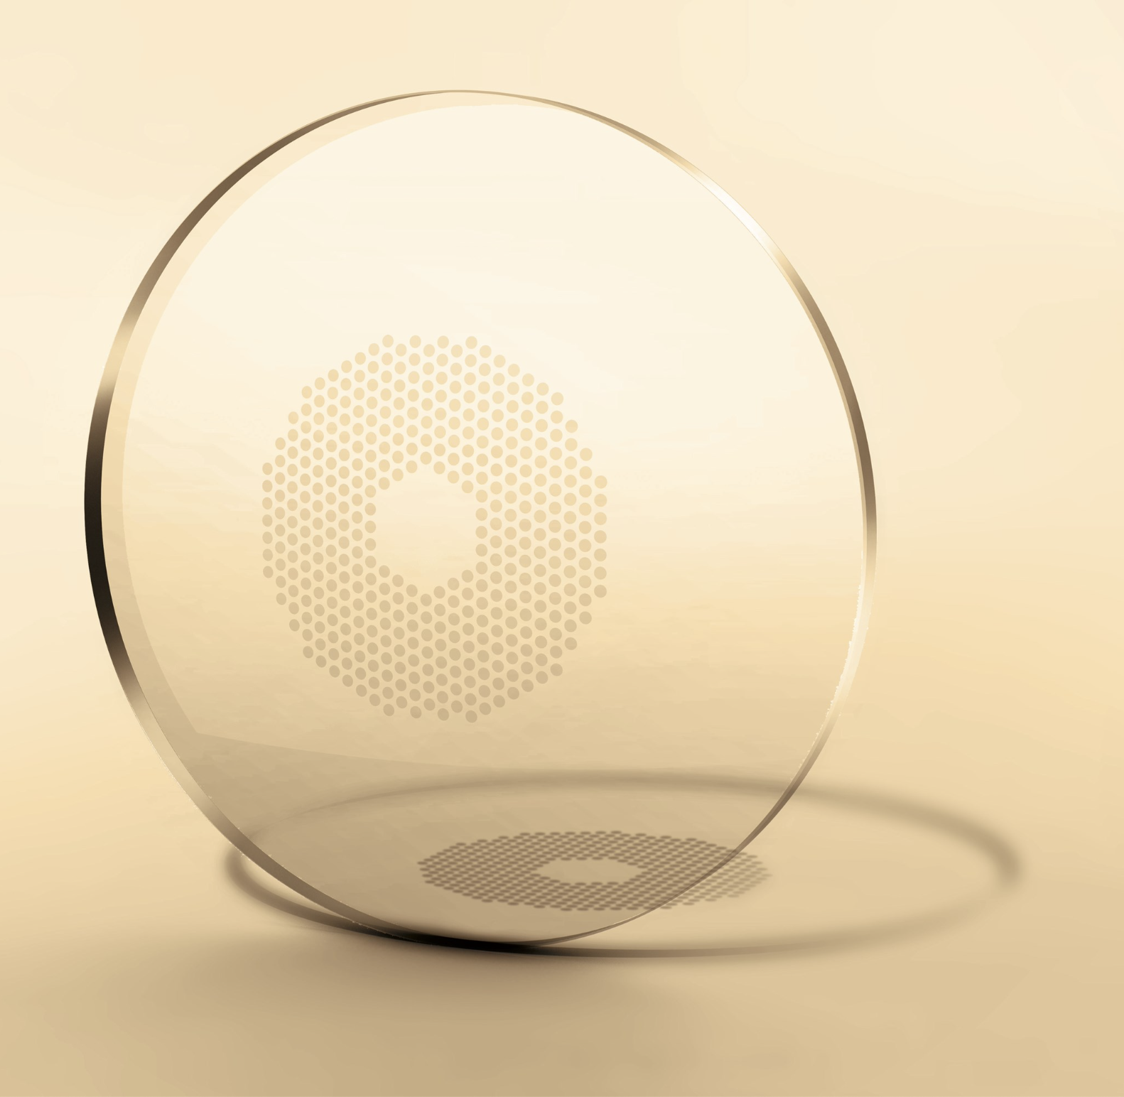
Defocus Incorporated Multiple Segments (DIMS) spectacle lenses
Looked at 160 children in DIMS lenses vs SV control group.
Found: myopia progressed 52% more slowly in Ref Error and 62% less axial elongation

Slide 22

Diffusion Optics (CYPRESS)
Looked into how reducing contrast in glasses can reduce myopia progression
What:
  256 myopic children (mean age 6-10 years)
  Looked at 12 month difference between spectacle wearing group vs control
What happened?
  Mean difference vs. control 12 months later was -0.40 D representing 74% reduction.
  Control group grew 0.15mm in axial length vs 0.10 in control

Slide 23
Undercorrection doesn’t work
What:
  94 myopic children between the ages of 9-14 years old
  Half the subjects were undercorrected (by roughly +0.75)
  -0.50 to -4.50D of myopia
What Happened?
  Mean progression after 2 years
    1.00D – Undercorrected group
    0.77D - Fully corrected group

Slide 24
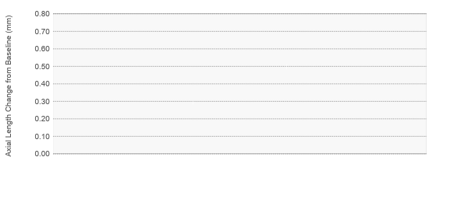
The importance of adherence to recommended wear time:
Graph comparing axial elongation between test and control groups during 2-year treatment period¹
59% slowing
39% slowing
50% faster progression
for part-time wearers
n=32
n=34
n=22
n=16
FULL-TIME WEARING GROUP
(≥12 hours/day)
PART-TIME WEARING GROUP
(<12 hours/day)
Stellest™ lens Control (Single vision)
Highly Aspheric Lenslets group
Bao J, Huang Y, Li X, et al. Spectacle Lenses With Aspherical Lenslets for Myopia Control vs Single-Vision Spectacle Lenses: A Randomized Clinical Trial. JAMA Ophthalmol. 2022;140(5):472–478.

Slide 25
Questions
Soft Multifocal Treatments

Slide 26
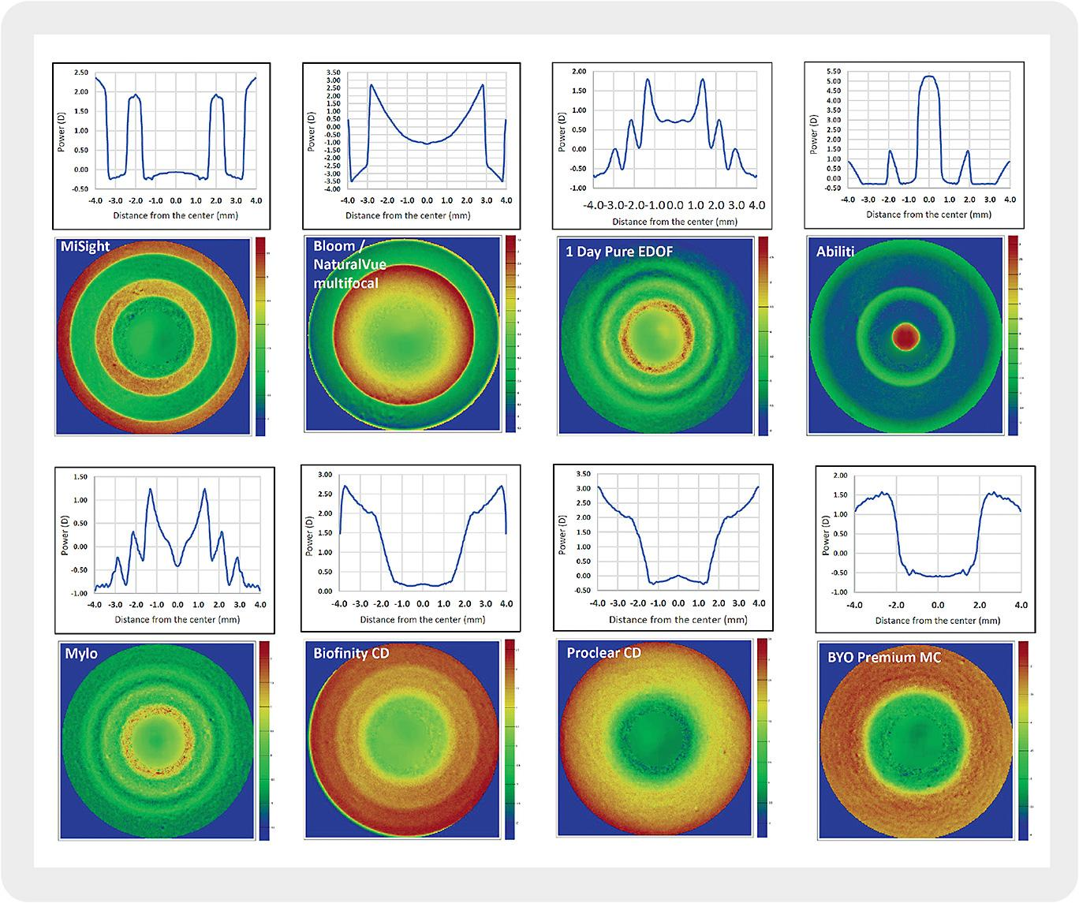
Eef van der Worp, Giancarlo Montani. Powerful Profiles. Contact Lens Spectrum, April 2023.
Notes:
Justin

Slide 27
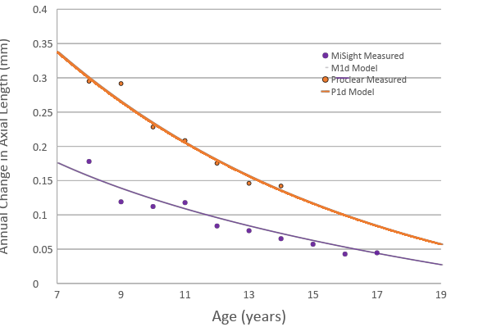
Cumulative MiSight Effect over 10 years provides an estimated 0.87mm of Slowing Eye Growth = more than 2.00D of Myopia Control
Analysis of MiSight study result by subject age
Average cumulative treatment effect
Approximately 50% slowing at each age.
**Analysis of treatment age and years in treatment needs further investigation and likely that both can be utilized to demonstrate treatment efficacy.
Notes:
Previous experts have said 1.00 D might be the ceiling of total efficacy regardless of treatment duration. But here, we see more than 2.00 D of myopia control over all ages in the study.

Slide 28
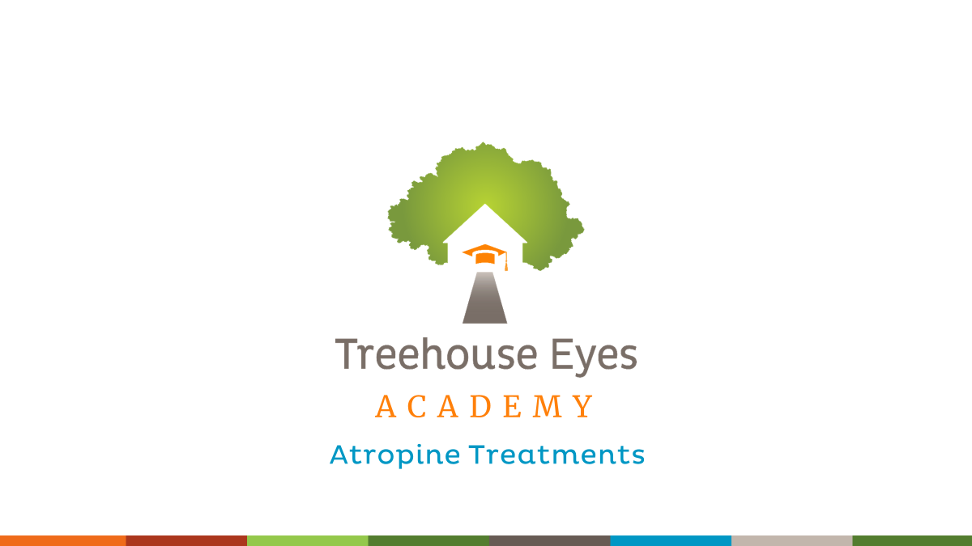

Slide 29


ATOM 1
ATOM 2
1% Atropine worked!
0.5% vs 0.1% vs 0.01%
Efficacy Results from the Atropine in the Treatment of Myopia (ATOM) StudyW. Chua; V. Balakrishnan; D. Tan; Y. Chan; ATOM Study Group Invest Ophthal Published:2006 ,
5 Year Clinical Trial Atropine in the Treatment of Myopia (ATOM2) StudyW. Chua; V. Balakrishnan; D. Tan; Y. Chan; ATOM Study Group Invest Ophthal Published:2014 ,

Slide 30
LAMP
438 Children ages 4-12 with myopia at least 1.0 Diopter over a year
4 groups:
0.05%, 0.025%, 0.01% and placebo given nightly to both eyes for 1 year
Randomized, double masked

Slide 31
Results (p < 0.001) Refractive error
0.05% | -0.27 +/- 0.61D
0.025% | -0.46 +/- 0.45D
0.01% | -0.59 +/- 0.61D
Placebo | -0.81 +/- 0.53D

Slide 32
Results (p < 0.001) Axial Length
0.05% | 0.20 +/- 0.25mm
0.025% | 0.29 +/- 0.20mm
0.01% | 0.36 +/- 0.29mm
Placebo | 0.41+/- 0.22mm

Slide 33
Results (p < 0.001) Accommodation
0.05% | 1.98 +/- 2.82 D
0.025% | 1.61 +/- 2.61 D
0.01% | 0.26 +/- 3.04 D
Placebo | 0.32 +/-2.91 D

Slide 34
Results (p < 0.001) Pupil Size photopic
0.05% | 1.03 +/- 1.02 mm
0.025% | 0.76 +/- 0.90 mm
0.01% | 0.49 +/- 0.80 mm
Placebo | 0.13 +/- 1.07 mm

Slide 35
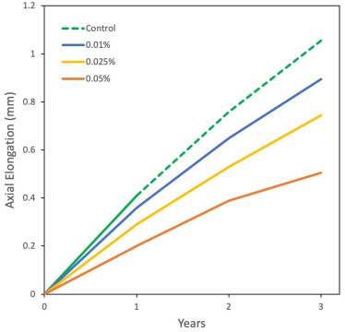
LAMP 3 Year Results
How much rebound effect?
0.05% Small (0.04 mm)
0.025% None
0.01% None

Slide 36
LAMP phase 2 -3
Switched the kids on placebo to 0.05% atropine
Found: SE change of 0.18D change in year 2 vs 0.82 in year 1.
AL: 0.15mm year 2 vs 0.43mm in year 1.
Phase 3: Tested washing out … and guess what. Those that washed out progressed faster than kids who stayed in treatment.

Slide 37
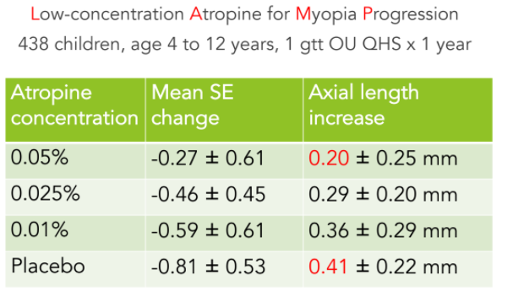
Low-Concentration Atropine for Myopia Progression (LAMP) Study
A Randomized, Double-Blinded, Placebo-Controlled Trial of 0.05%, 0.025%, and 0.01% Atropine Eye Drops in Myopia ControlJason C. Yam, FCOphthHK, FRCS(Edin) Yuning Jiang, MMED Shu Min Tang, PhD Clement C. Tham, FCOphthHK, FRCOphthLi Jia Chen, MRCSEd(Ophth), PhD Chi Pui Pang, DPhil Published:July 06, 2018DOI:https://doi.org/10.1016/j.ophtha.2018.05.029

Slide 38
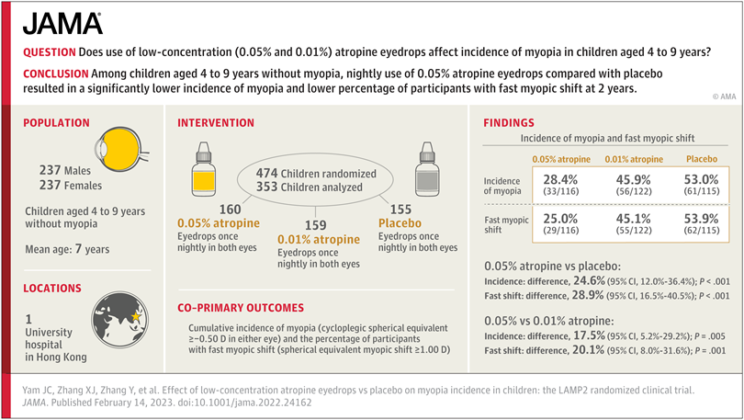


Slide 39


Slide 40
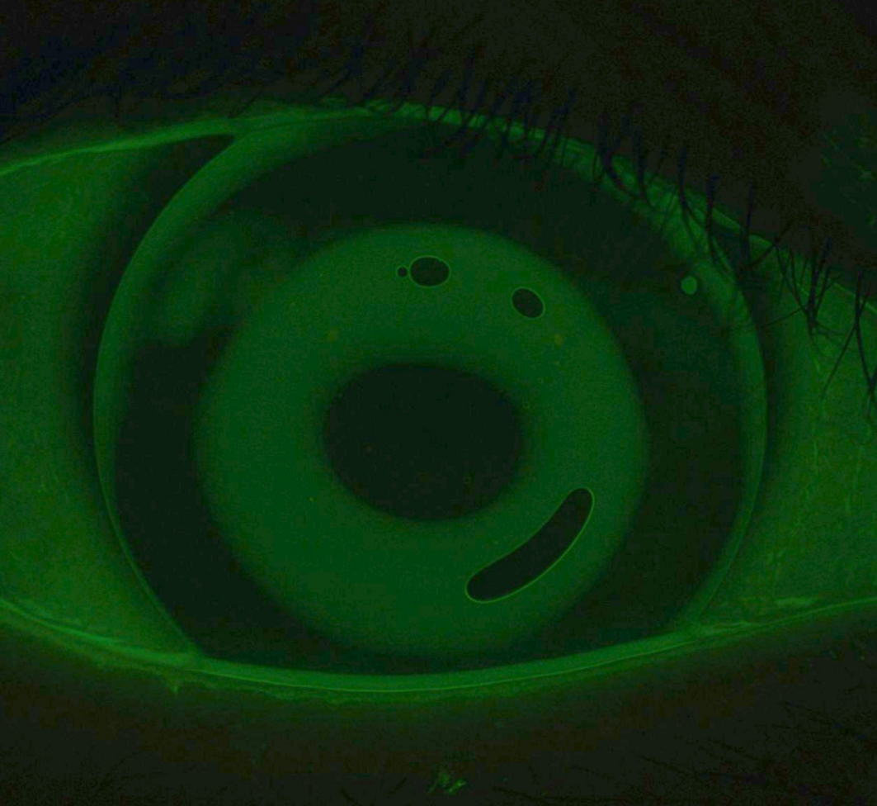
SMART Study
What:
  382 myopia children
  Followed for 3 years
  172 treated with OK
  110 treated with SV CLs
What happened?!
  -0.13 +/- 0.62 diopters in the OK group
  -1.03 +/-0.58 diopters in the SV CL group

Slide 41

CAMP Study
What:
  342 myopia children
  Followed for 3 years
What happened?!
  70% of patients had less than 0.10mm per year of axial elongation on OrthoK
  78% OK patient stay
  68% Soft MF
  22% Atropine

Slide 42
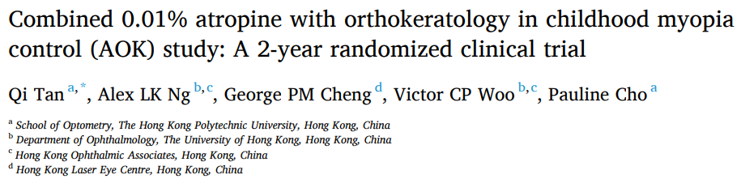
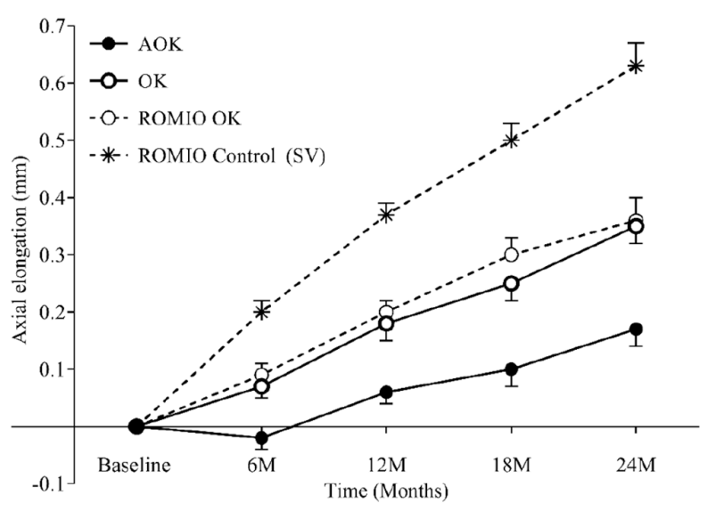
Notes:
Ariel
Slower axial elongation following 2-year AOK treatment may result from increased pupil dilation and a thickening in the choroid observed in the AOK group.

Slide 43
Questions
Light Treatment

Slide 44

Light therapy
  Low Level Red Light: 1031 myopic children age 6-16. Repeated low level red light significantly reduced axial length.
  Violet light: Compared children wearing UV block CLs vs transmissible and transmissible CLs suppressed myopia the most. 1 year later 0.014mm vs 0.19mm in UV blocking vs transmissible
  78% OK patient stay
  68% Soft MF
  22% Atropine

Slide 45
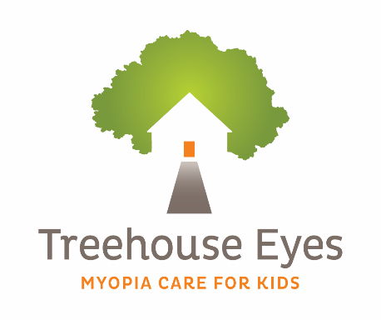
Questions
Questions?
We think big for little eyes.

