Slide 1
We think big for little eyes.

Slide 2

Myopia Management during the COVID-19 Pandemic
Dr. Gary Gerber
COPE Course ID: 68357-GO

Slide 3

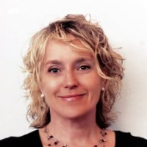

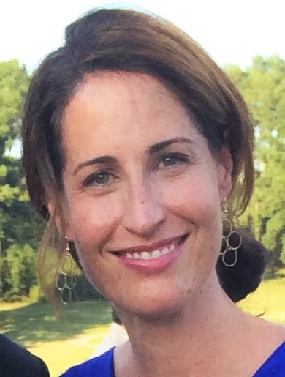

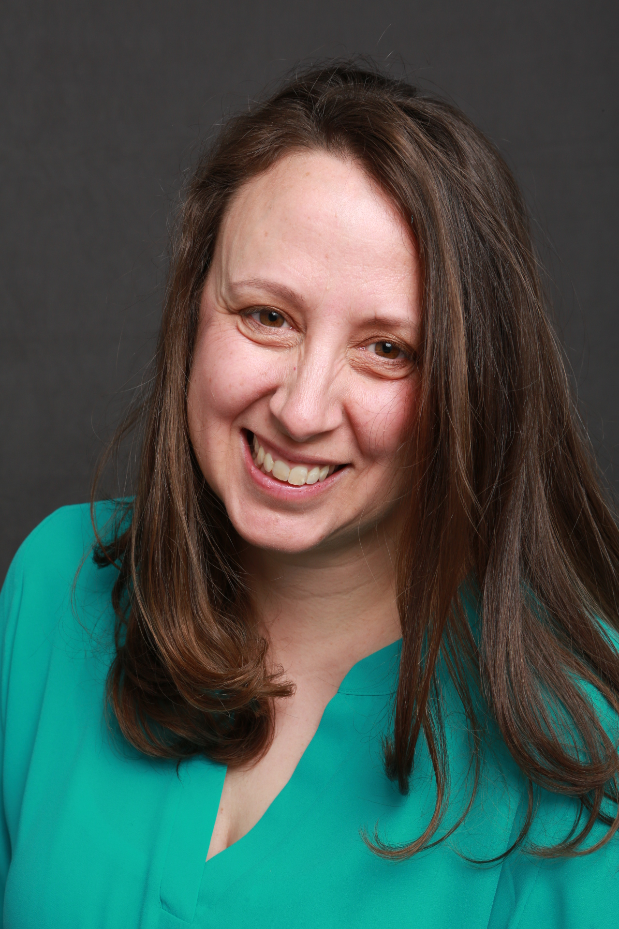
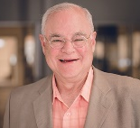
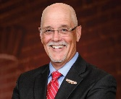
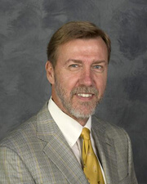
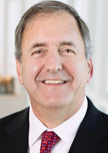
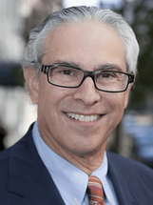

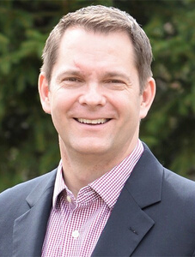
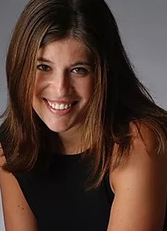
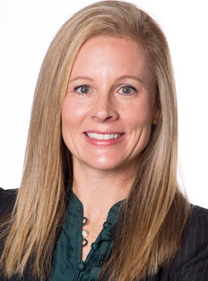
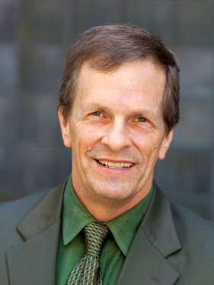
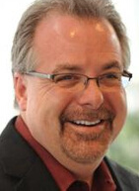

The Treehouse Eyes Team
Patient Experience
Implementation
Carlee Cardwell
Rachel Falbaum
Dr. Gary Gerber
Dr. Bethany Fishbein
Commercial Advisory Board
Scientific Advisory Board
Marketing & PR
Dean Butler
Don Fox
Dr. Earl Smith
Dr. Vance Thompson
Dr. Jeffrey Cooper
Matt Oerding Jennifer Babbit Bodner
Dr. Erin Stahl
Dr. Thomas Aller
Patrick Caroline

Slide 4
What is myopia and what are we managing?
    Is myopia normal?
    What about presbyopia?
    Is myopia a disease?
    Is blurry vision a disease?
    Myopia is a disease whose symptom is blurry vision.
    What is the disease?
    “Your kid’s eye is too big.” (We know because we measure it!)

Slide 5

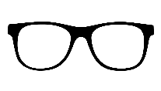
Myopia (nearsightedness) is an epidemic
25
%
700
yrs

Slide 6
Myopia is an epidemic
25
%
700
yrs

Slide 7
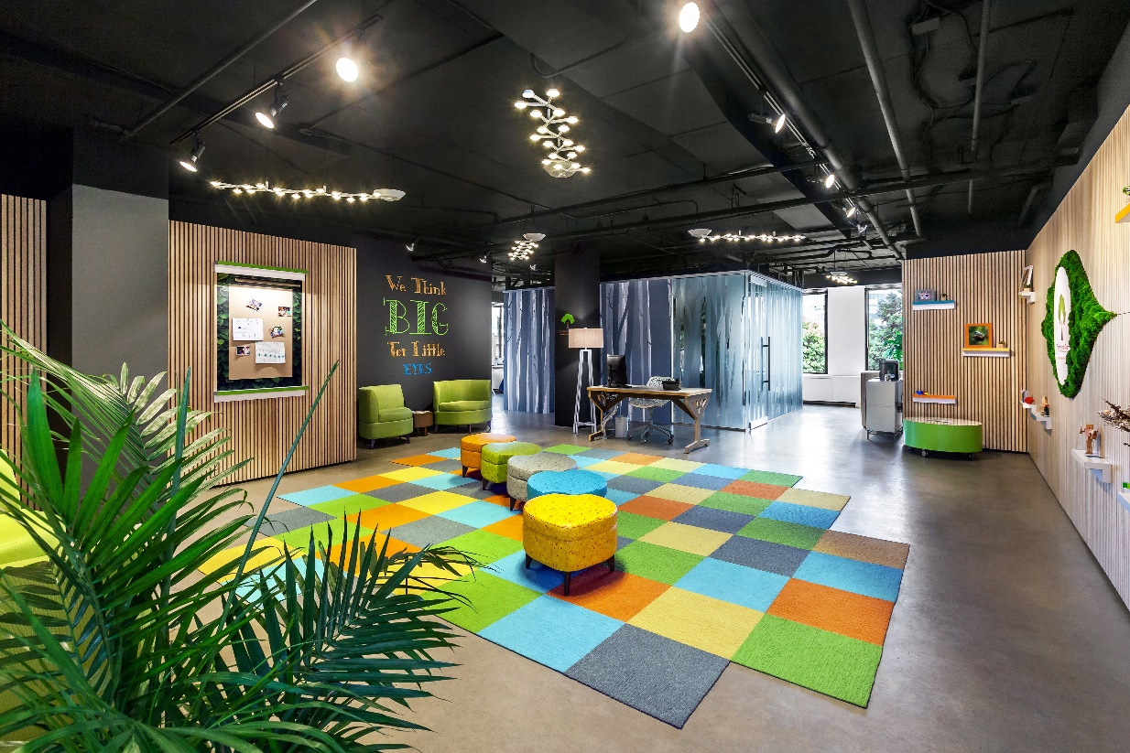


Slide 8
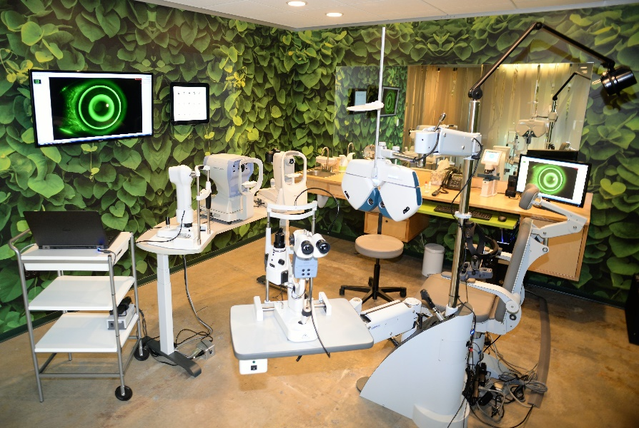
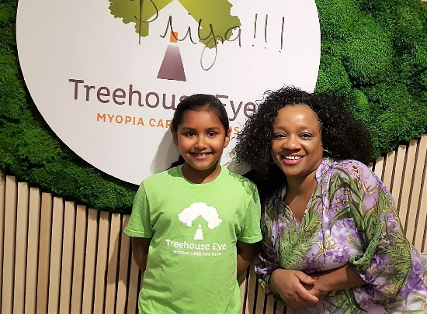
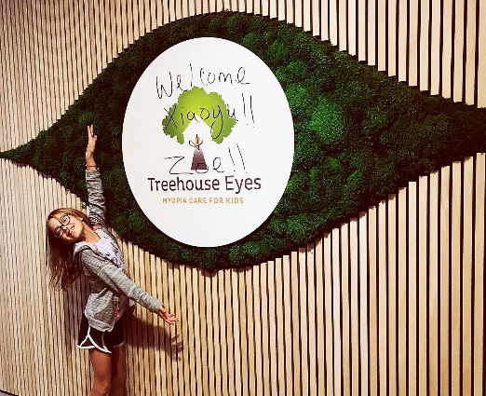

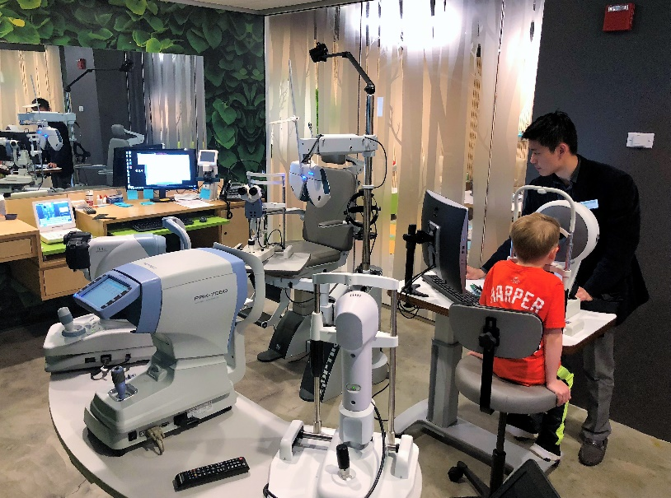
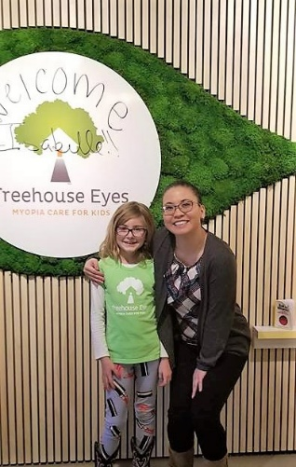
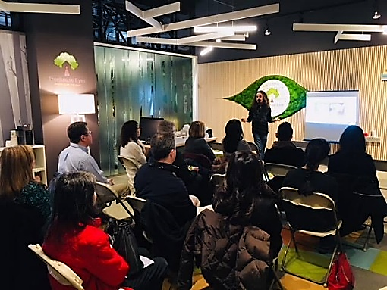
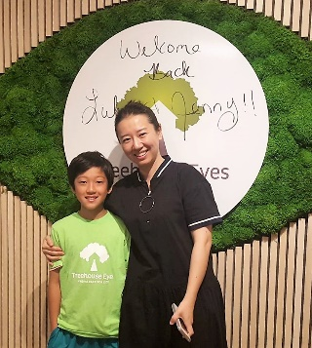

Slide 9
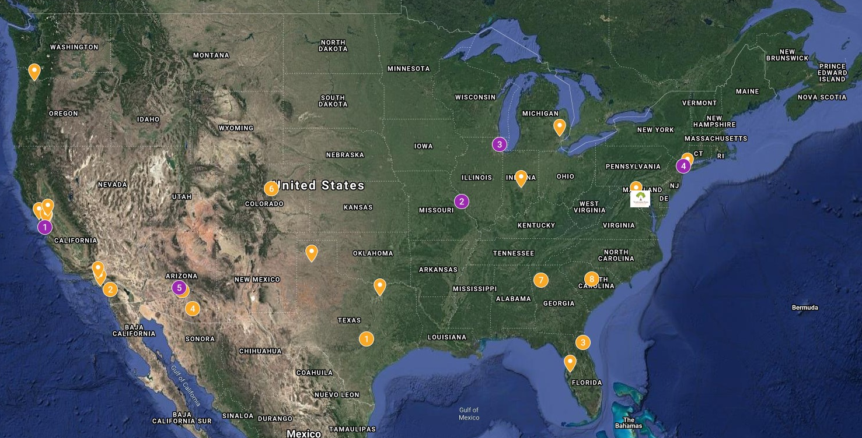

Slide 10
Myopia (nearsightedness) is an epidemic
25
%
700
yrs

Slide 11
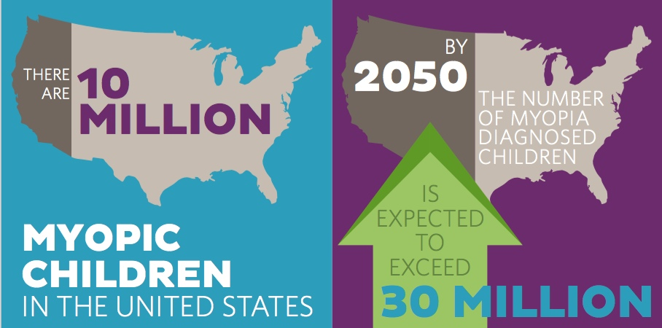

Slide 12
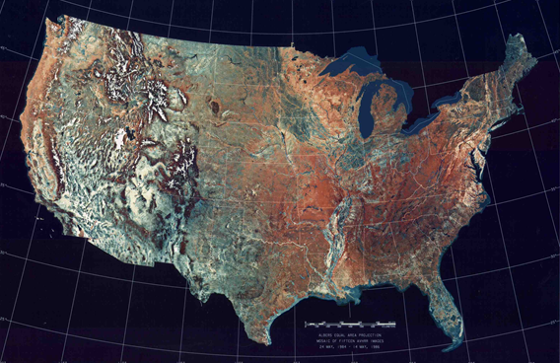
Increased Prevalence of Myopia in the US Between 1971-1972 and 1999 -2004
Susan Vitale PhD, Robert Sperduto MD, Frederick Ferris MD
Archives of Ophthalmology Vol. 127 No. 12 December 2009
Ages 12 -54
1971-1972 1999-2004
25.0% 41.6%
Myopic Myopic Myopic
A 66% increase in myopia in only 30 years!

Slide 13
“Myopia is twice as big of a problem as obesity”
BCLA May 2015
Ian Flitcroft MA DPHIL FRCOPHTH

Slide 14
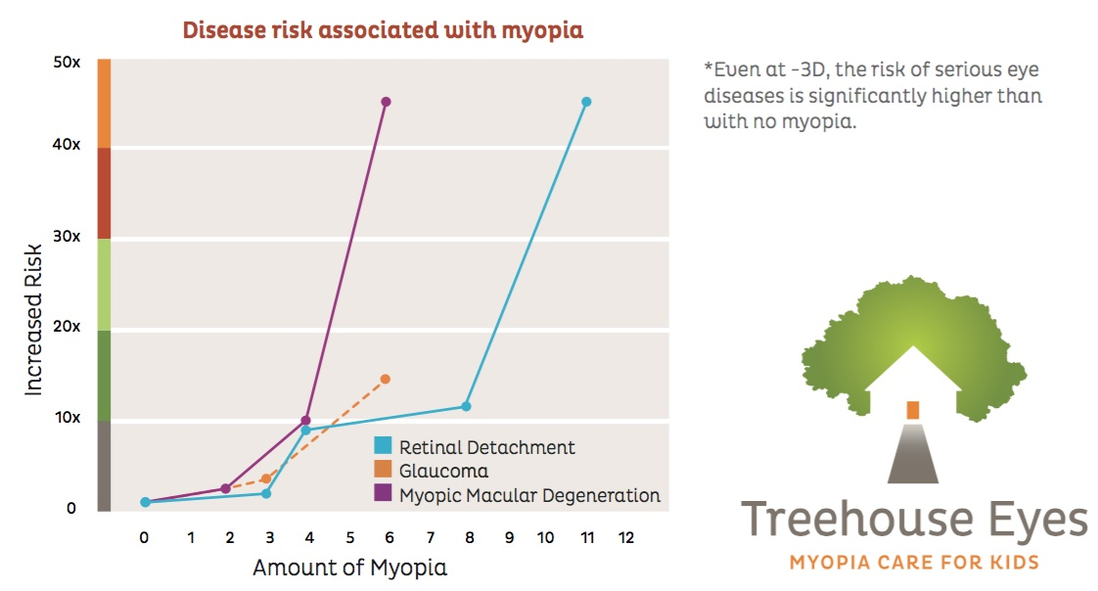
Problem: Myopia starts in children and progresses
Higher myopia proven to increase sight threatening disease risk

Slide 15
“Physiological myopia does not exist.
There is no safe level of myopia.”
Ian Flitcroft MA, DPHIL, FRCOPHTH
“Myopic kids get worse.”
Earl Smith, OD, FAAO, PhD

Slide 16
What's causing all this myopia?
The Nature Argument
    Myopia in both parents = 35%
    Myopia in one parent = 25%
    No myopic parents = < 10%
    Females more myopic than males

Slide 17
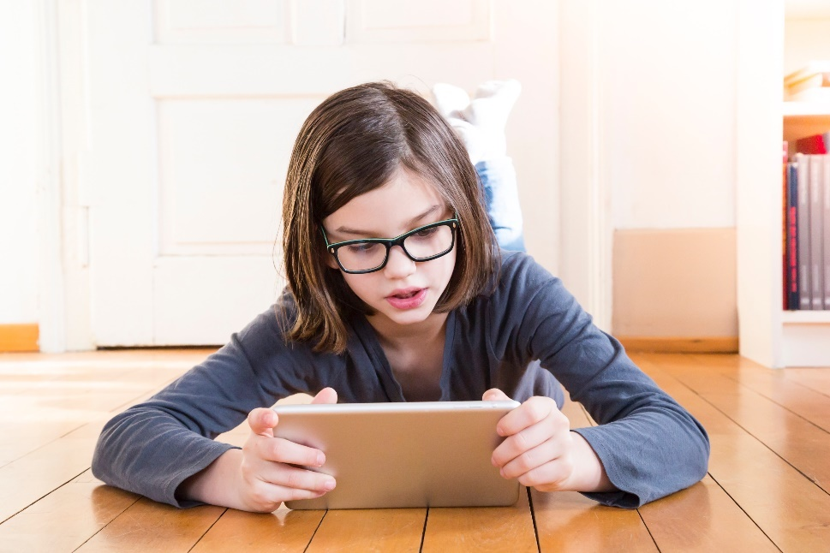

What's causing all this myopia?
The Nurture Argument

Slide 18
Dr. Monica Jong - Brien Holden Vision Institute
FedOpto Medillian Columbia 2015
“70% of todays myopia is environmentally driven. 30% is genetic.”
Lack of outdoor time
Near demand (?)

Slide 19
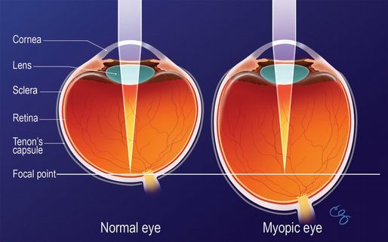
The underlying physiology of myopia

Slide 20
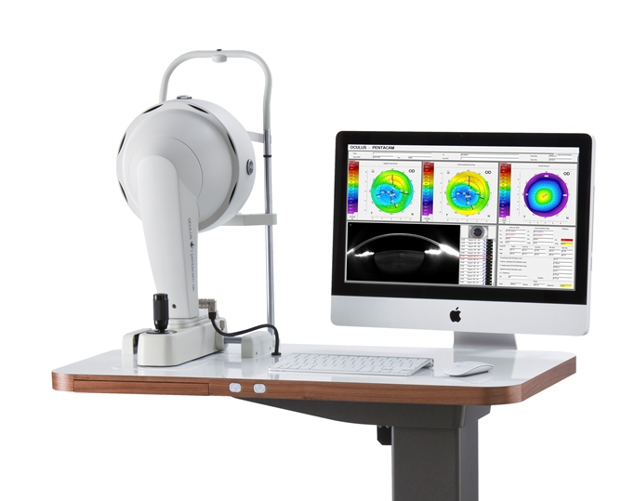
How do you know a myopic eye is too big?
    You measure it!
    Axial length vs. Diopters
    0.05 mm ~ 0.15 D

Slide 21
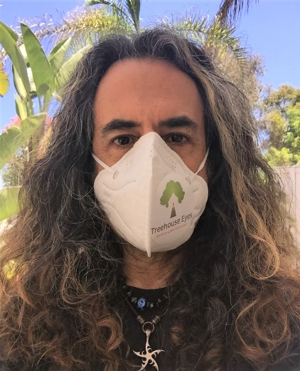
What is unique about COVID-19 and a myopia management practice?
100% of patients are kids, therefore . . .
You never have only the patient visiting you
PPE considerations
Over communicate with parents in advance of appointment - example

Slide 22
Social distancing is NOT only about keeping six feet apart!
    From the CDC:
    “Data are insufficient to precisely define the duration of time that constitutes a prolonged exposure. Recommendations vary on the length of time of exposure, but 15 minutes of close exposure can be used as an operational definition. Brief interactions are less likely to result in transmission; however, symptoms and the type of interaction (e.g., did the infected person cough directly into the face of the exposed individual) remain important.”

Slide 23
So if social distancing isn’t just about “6 feet,” but also includes the time of exposure, does telehealth have a place in myopia management?

Slide 24
And, if we can’t (yet) measure axial length remotely, does telehealth have a place in myopia management?
Axial length – objective, gold standard
Tx decisions based on AL
Rx – objective (cycloplegic AR)
VA –important, won’t be used by itself for Tx decisions
History and consultation – still critically important

Slide 25
And, if we can’t (yet) measure axial length remotely, does telehealth have a place in myopia management?
History and consultation – still critically important
VA –important, won’t be used by itself for Tx decisions

Slide 26
Does telehealth have a place in a myopia management practice?
Initial visit

Slide 27
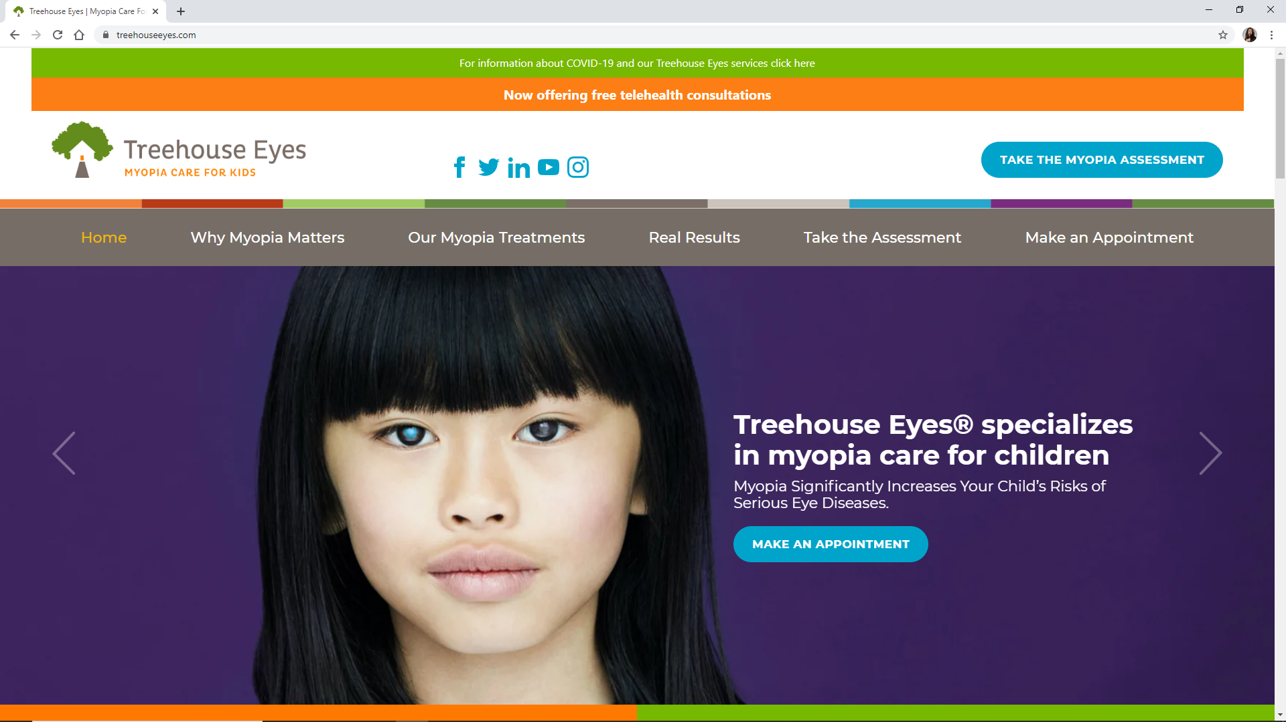

Slide 28
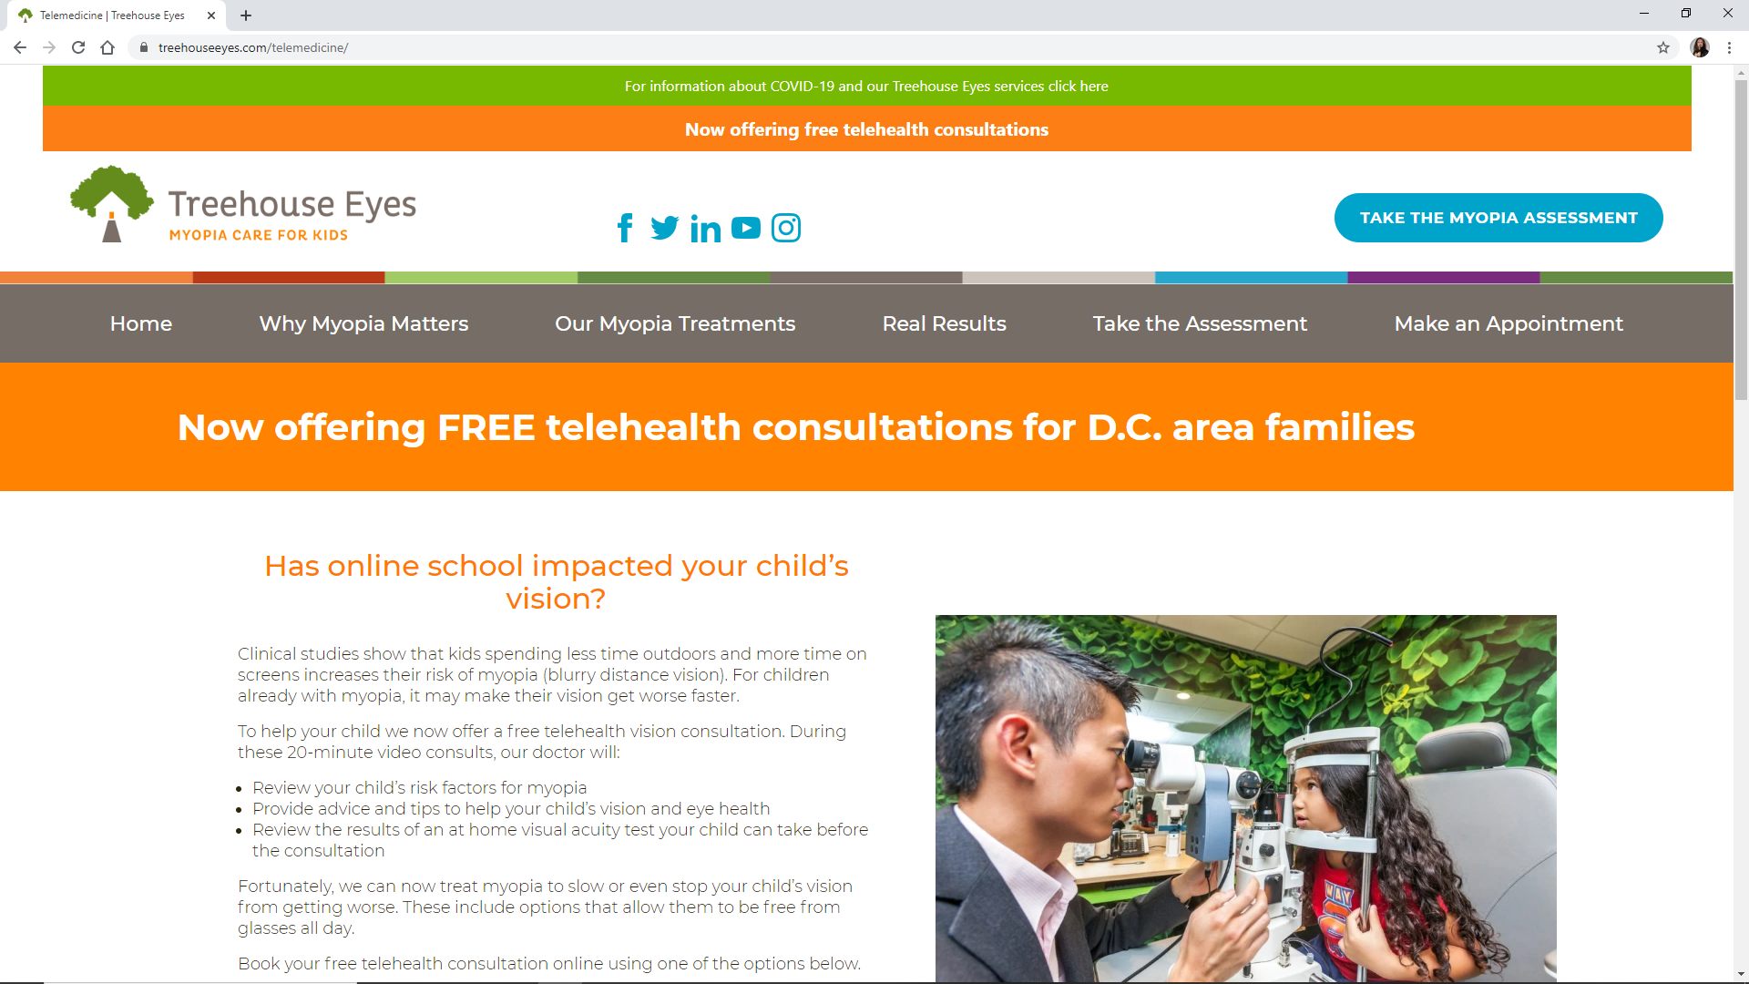

Slide 29
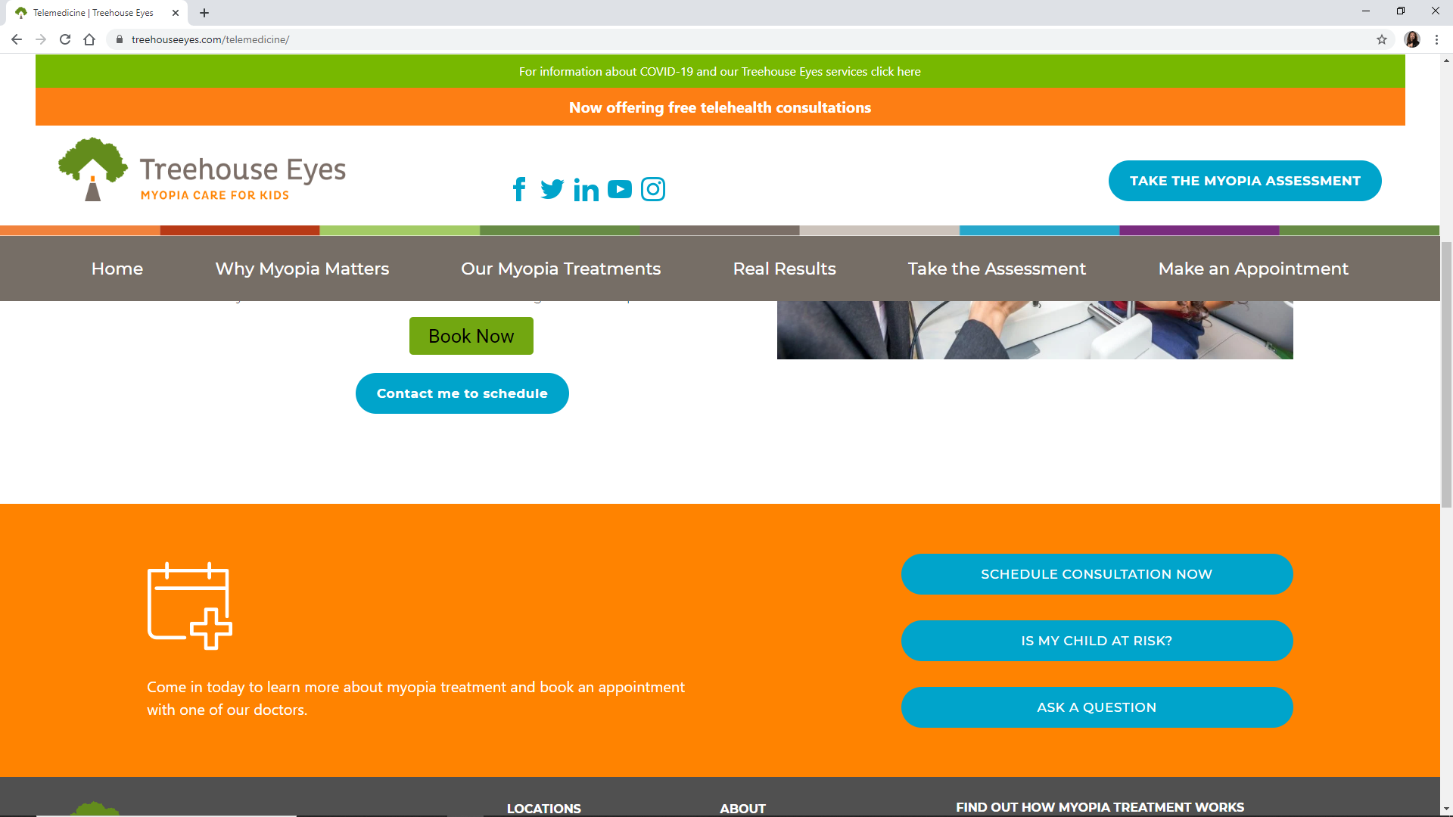

Slide 30
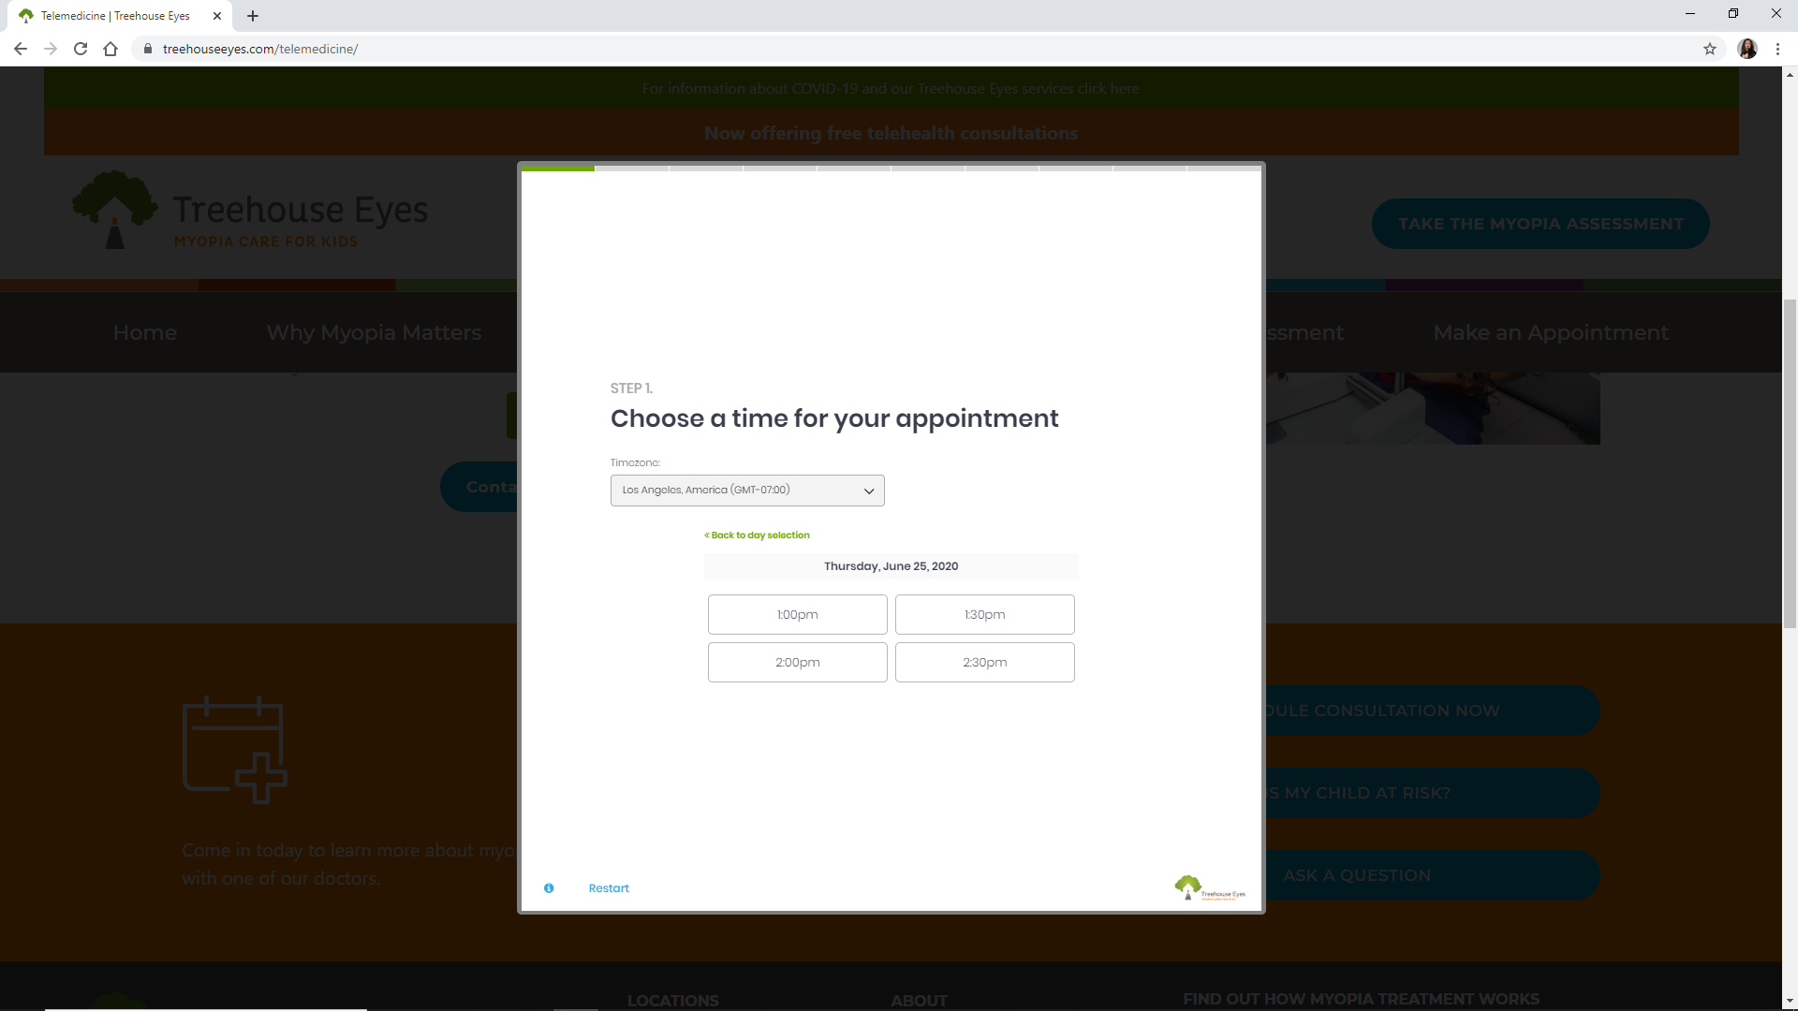

Slide 31
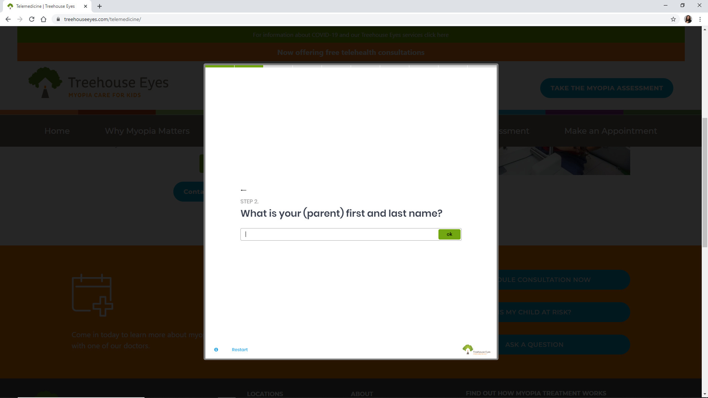

Slide 32
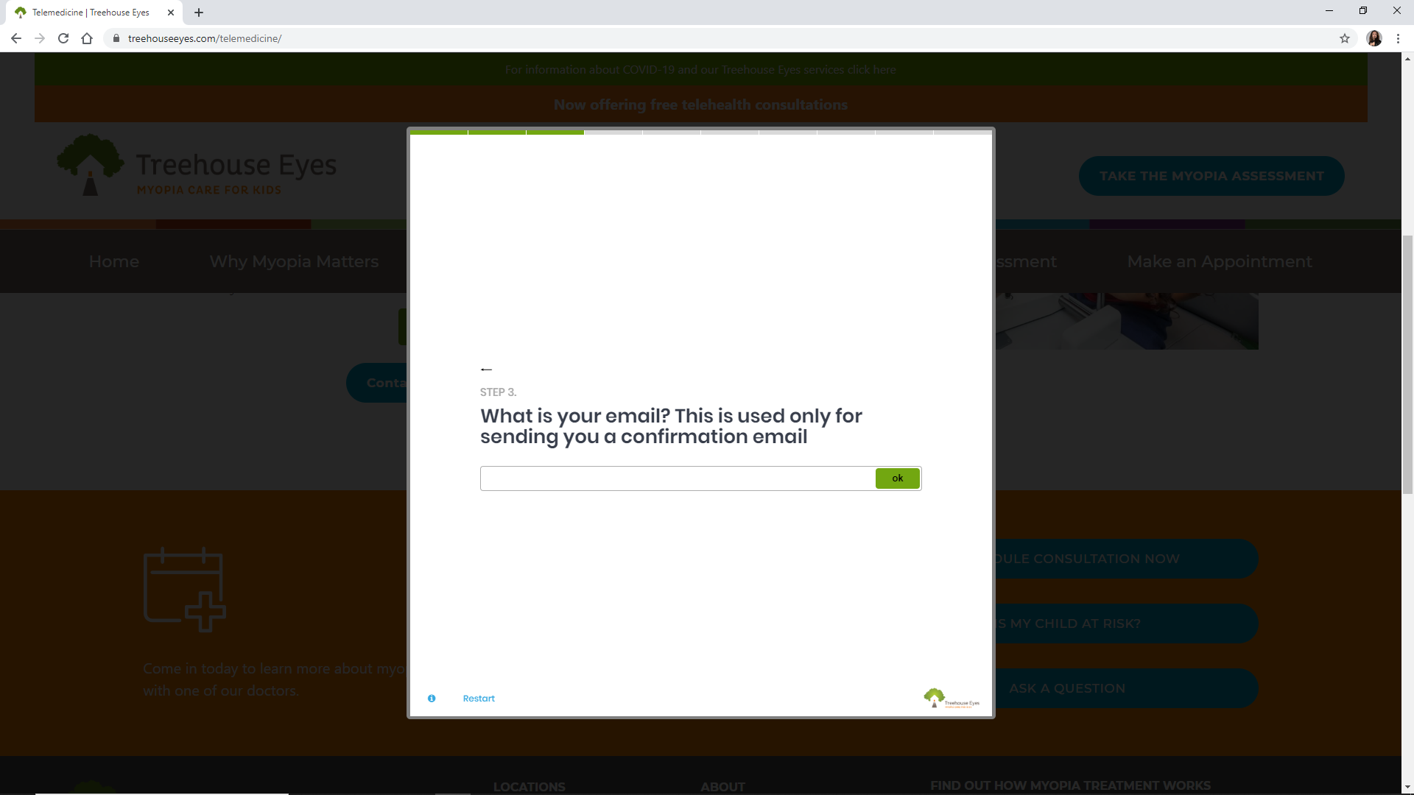

Slide 33
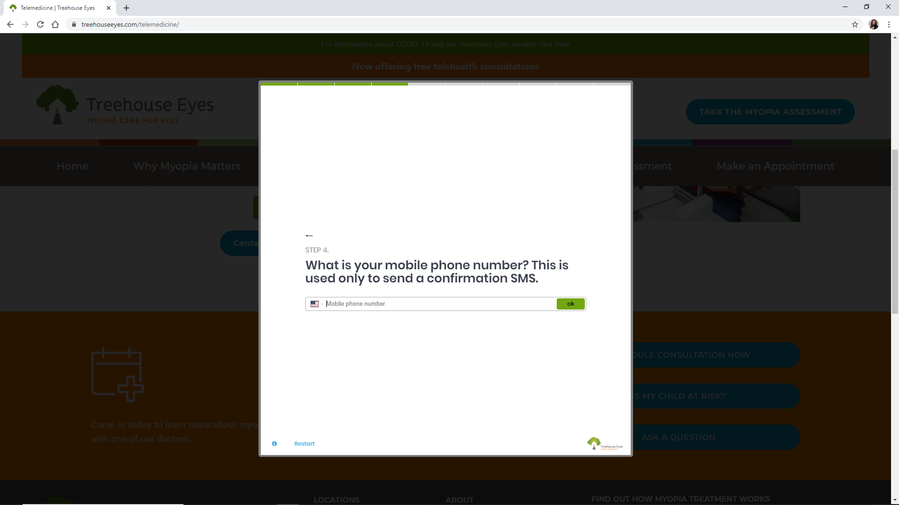

Slide 34
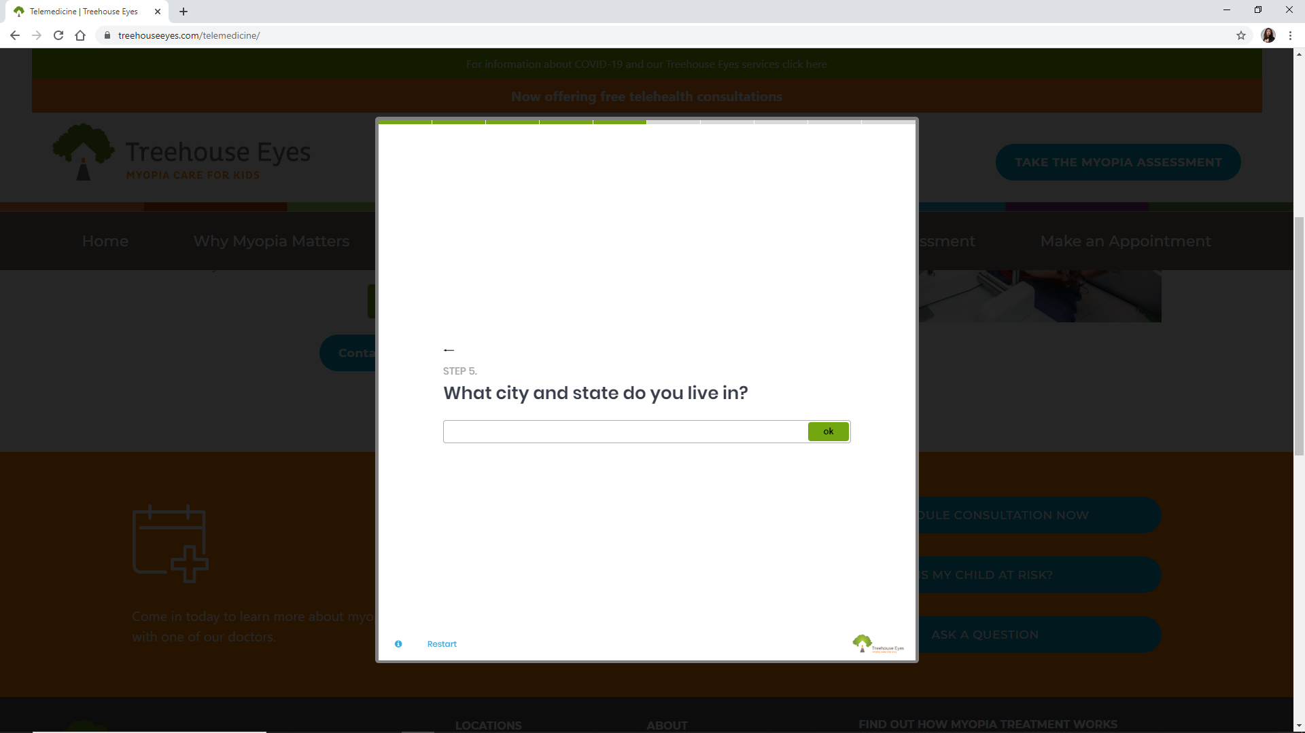

Slide 35
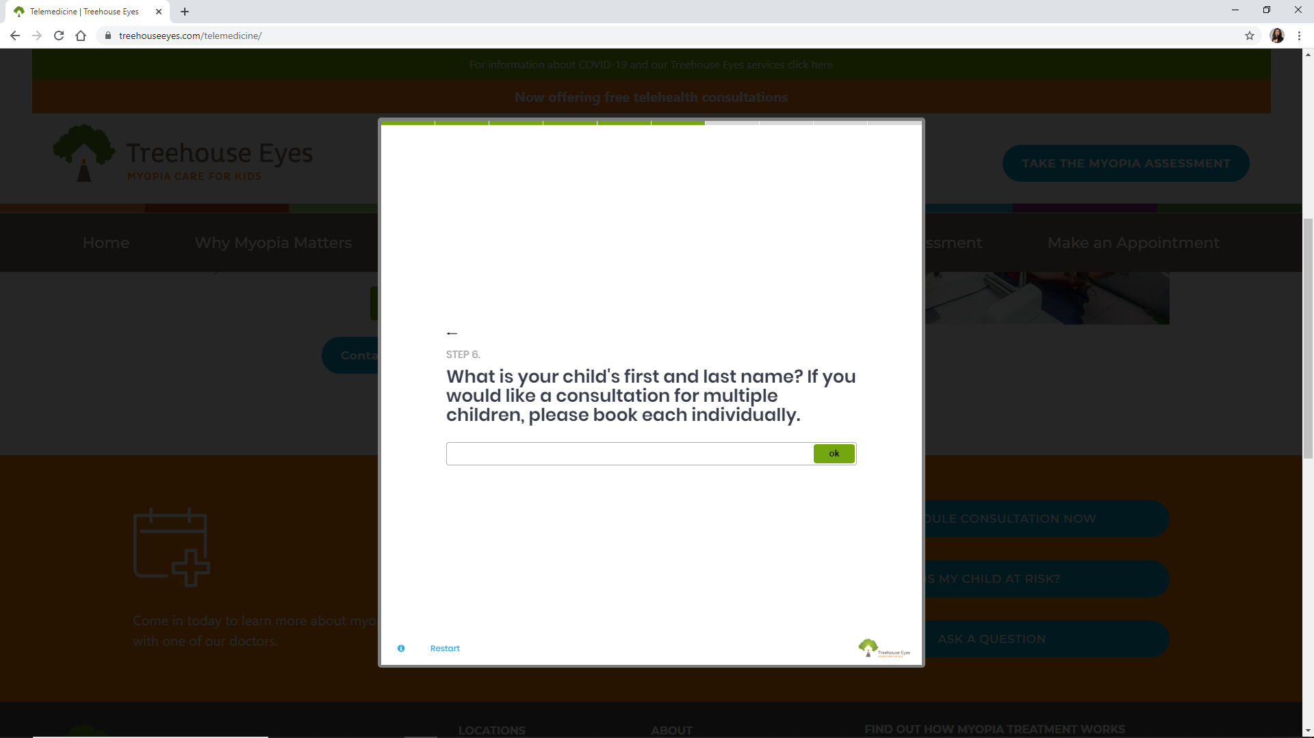

Slide 36
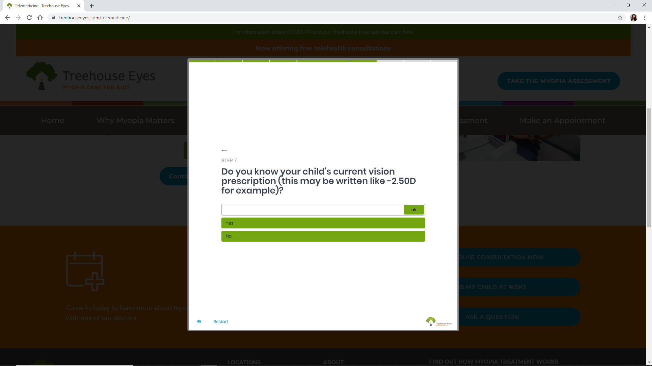

Slide 37
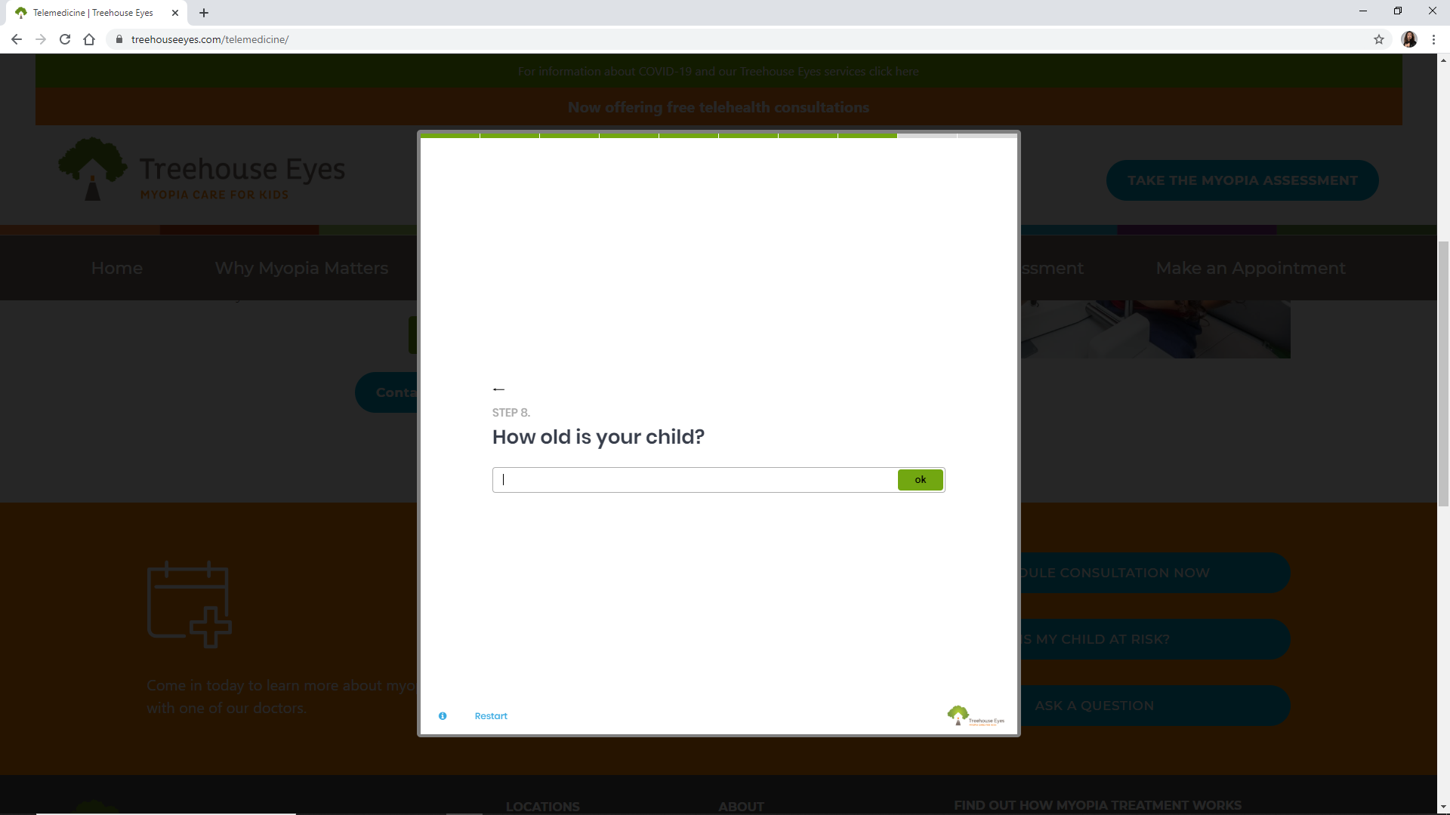

Slide 38
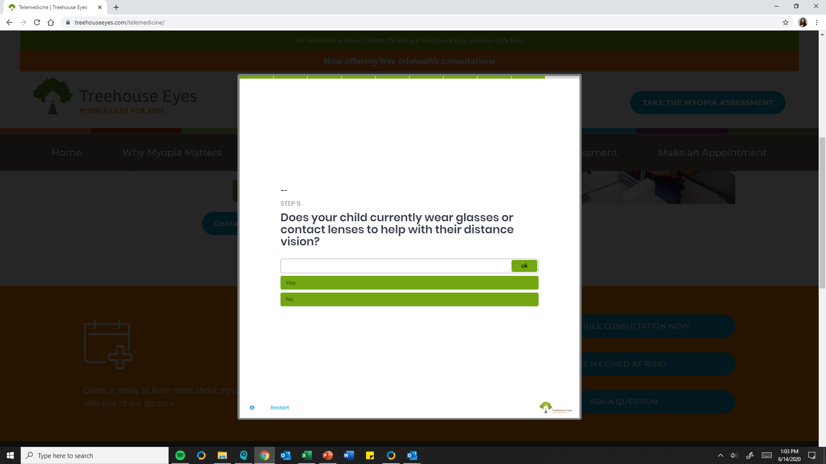

Slide 39
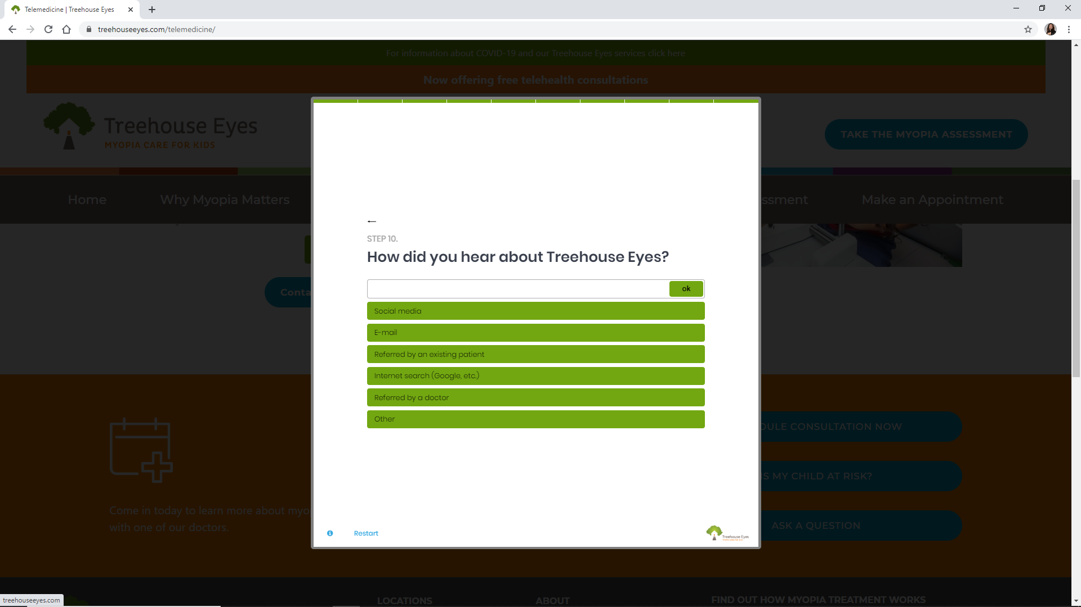

Slide 40
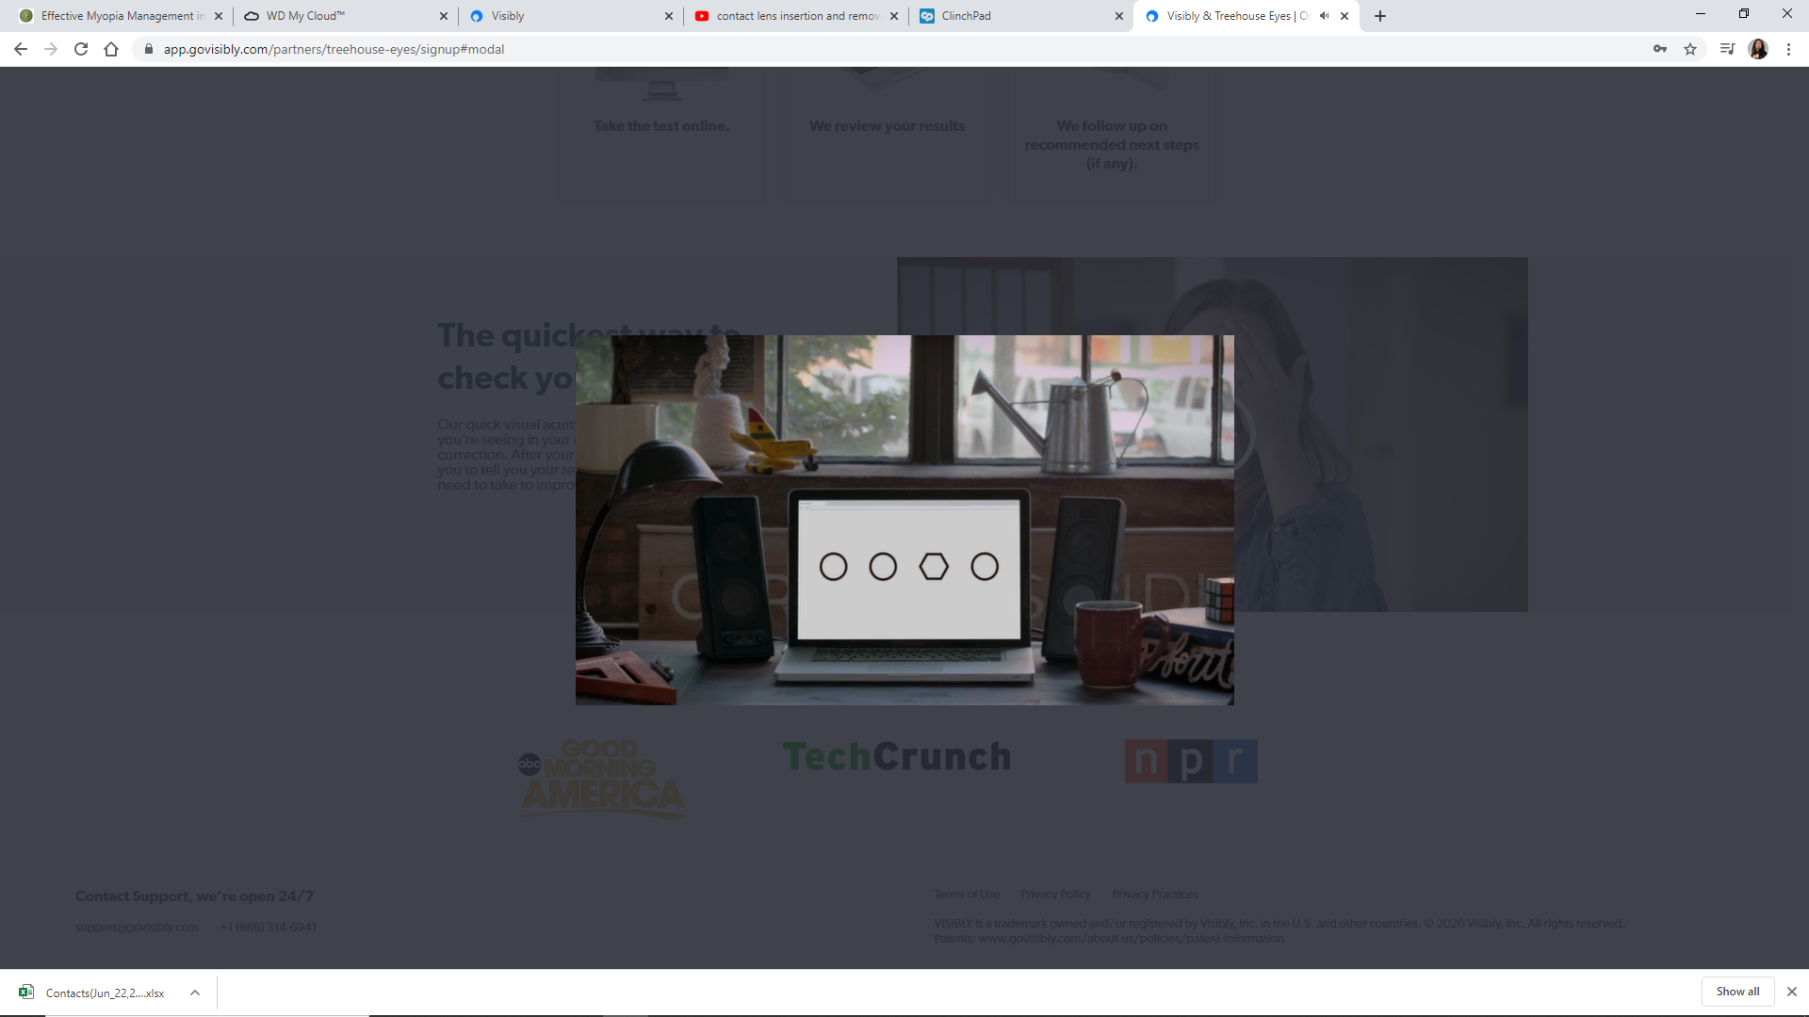
At home VA test screen grab

Slide 41
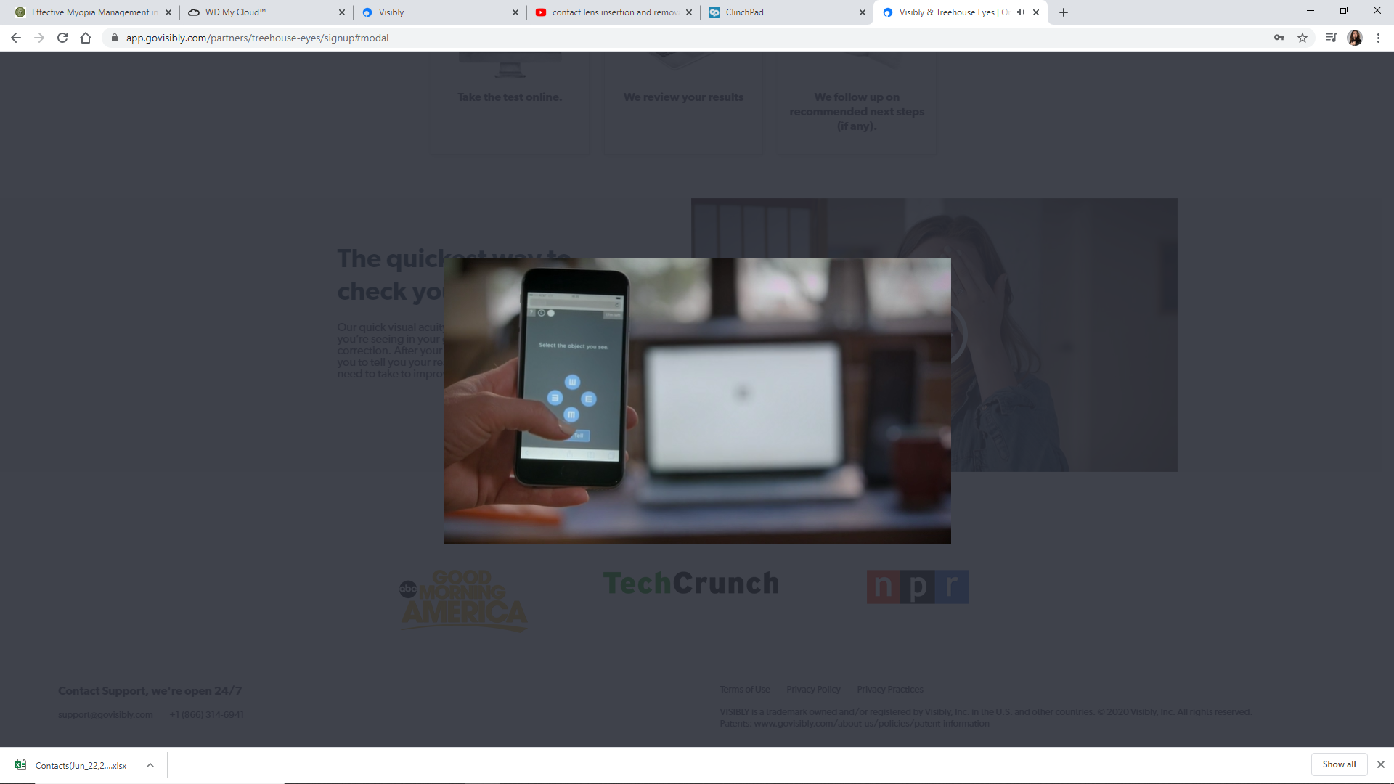

Slide 42
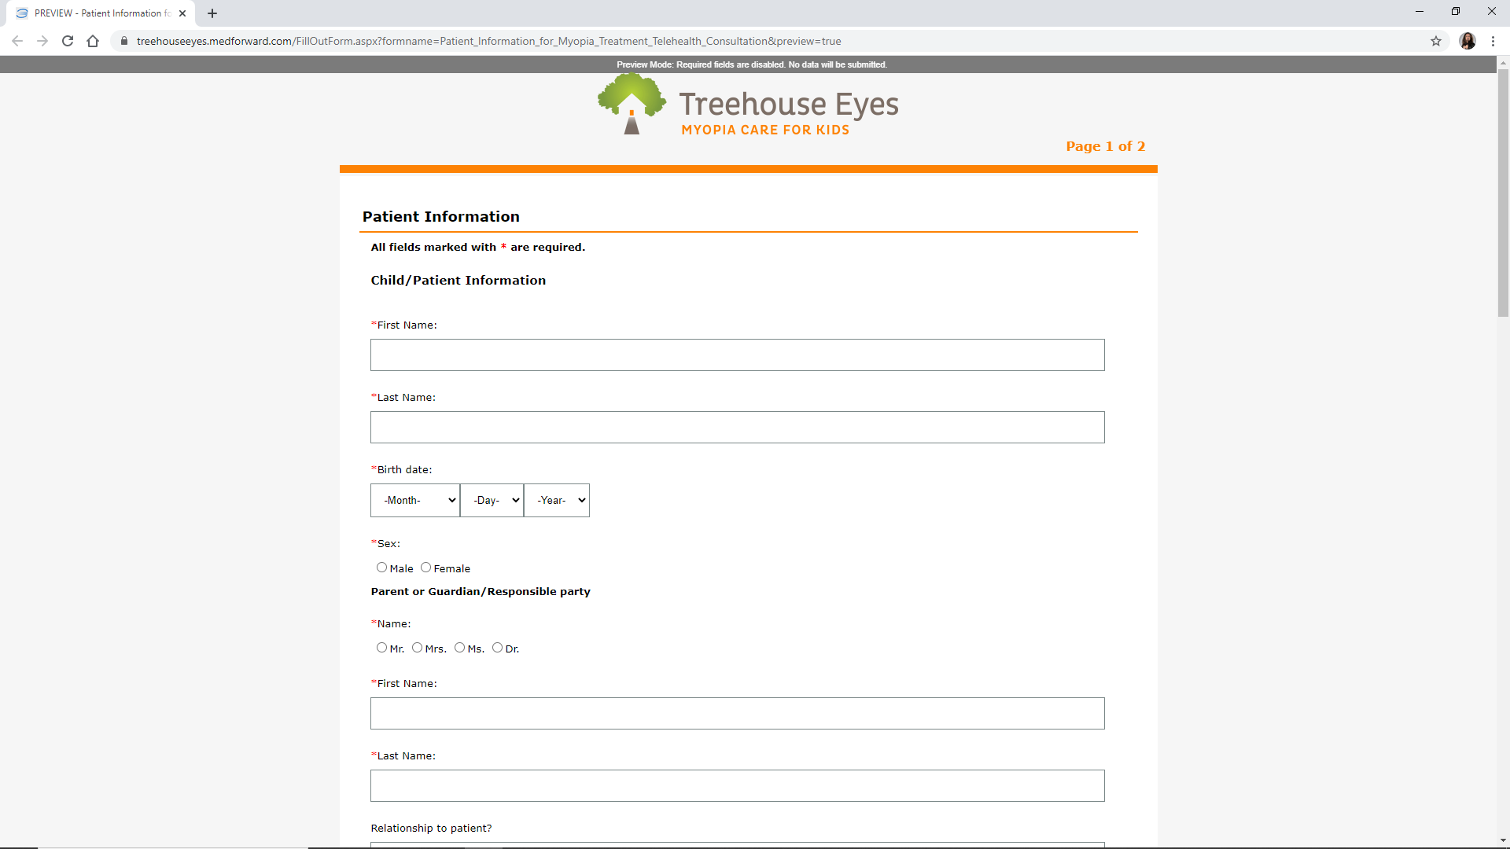

Slide 43
Does telehealth have a place in a myopia management practice?
Initial visit?
After a patient is treated?

Slide 44
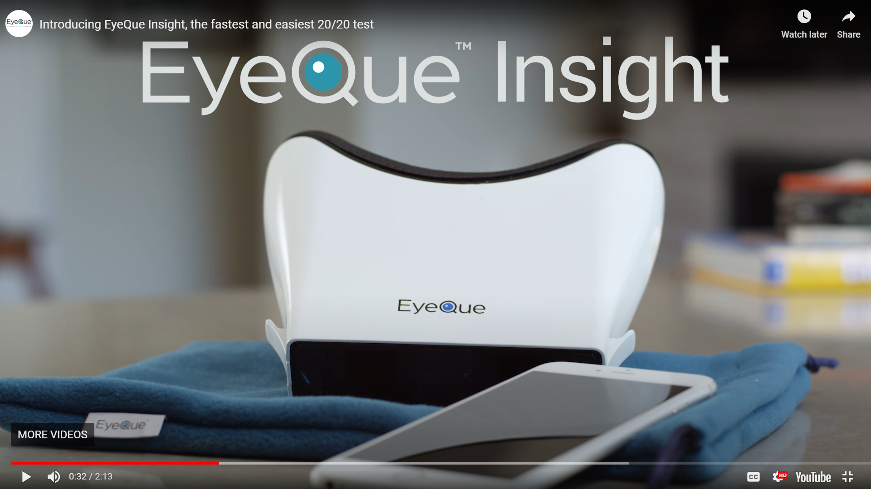

Slide 45
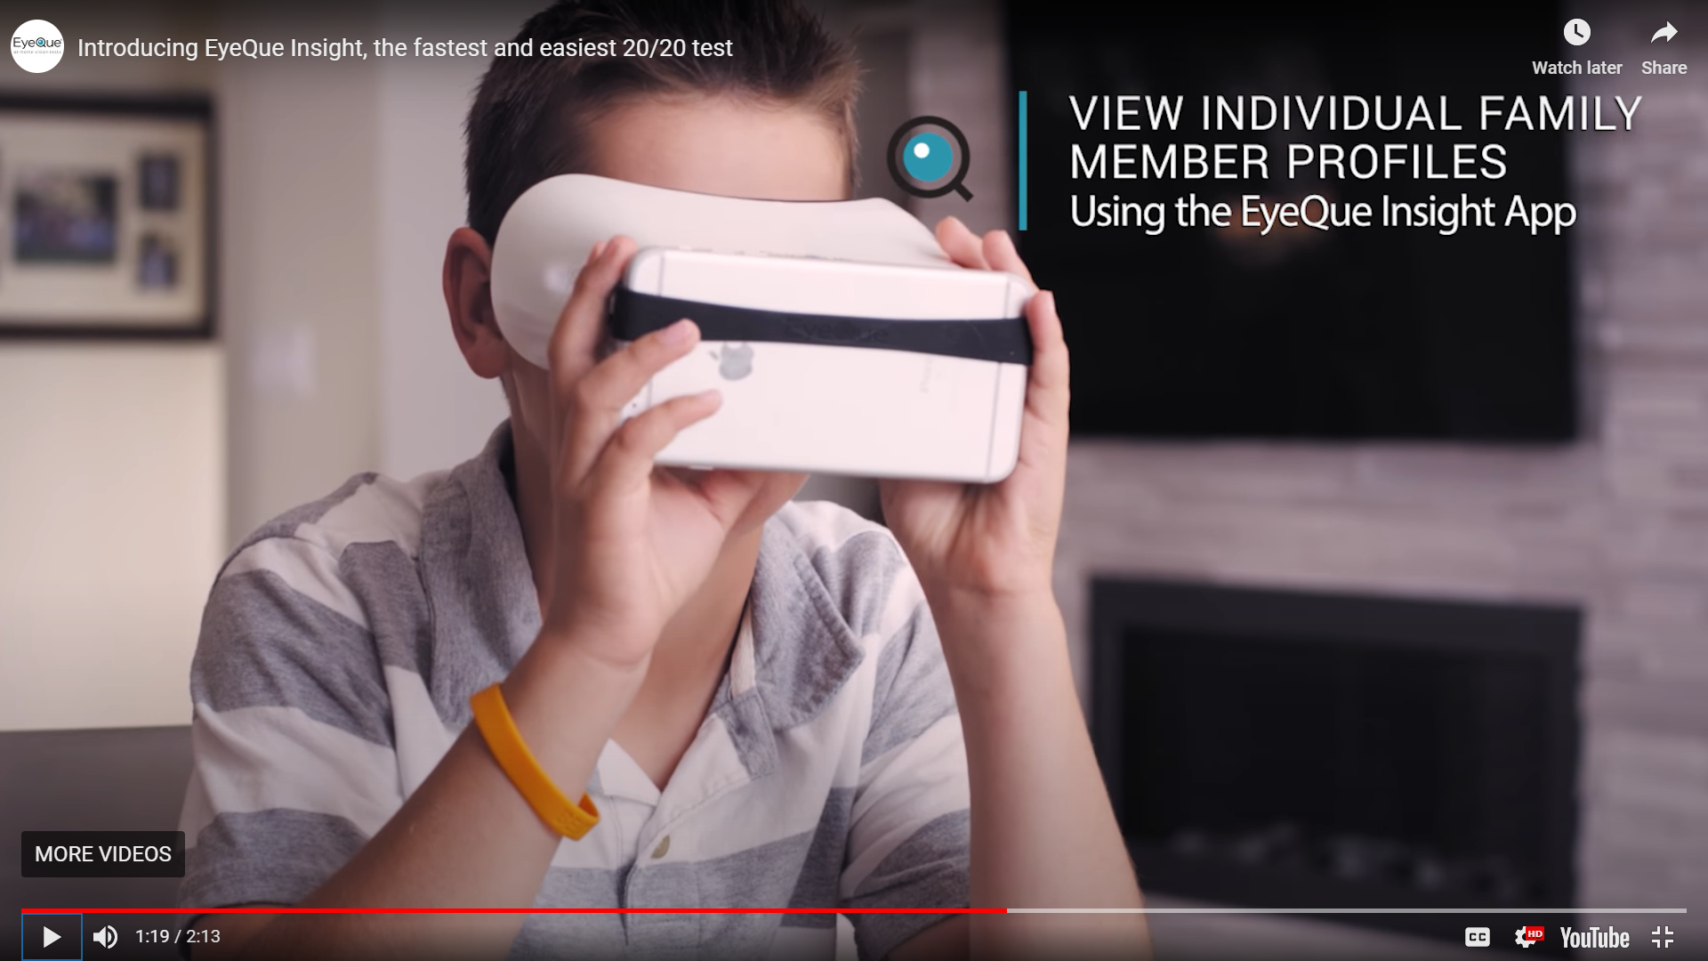

Slide 46
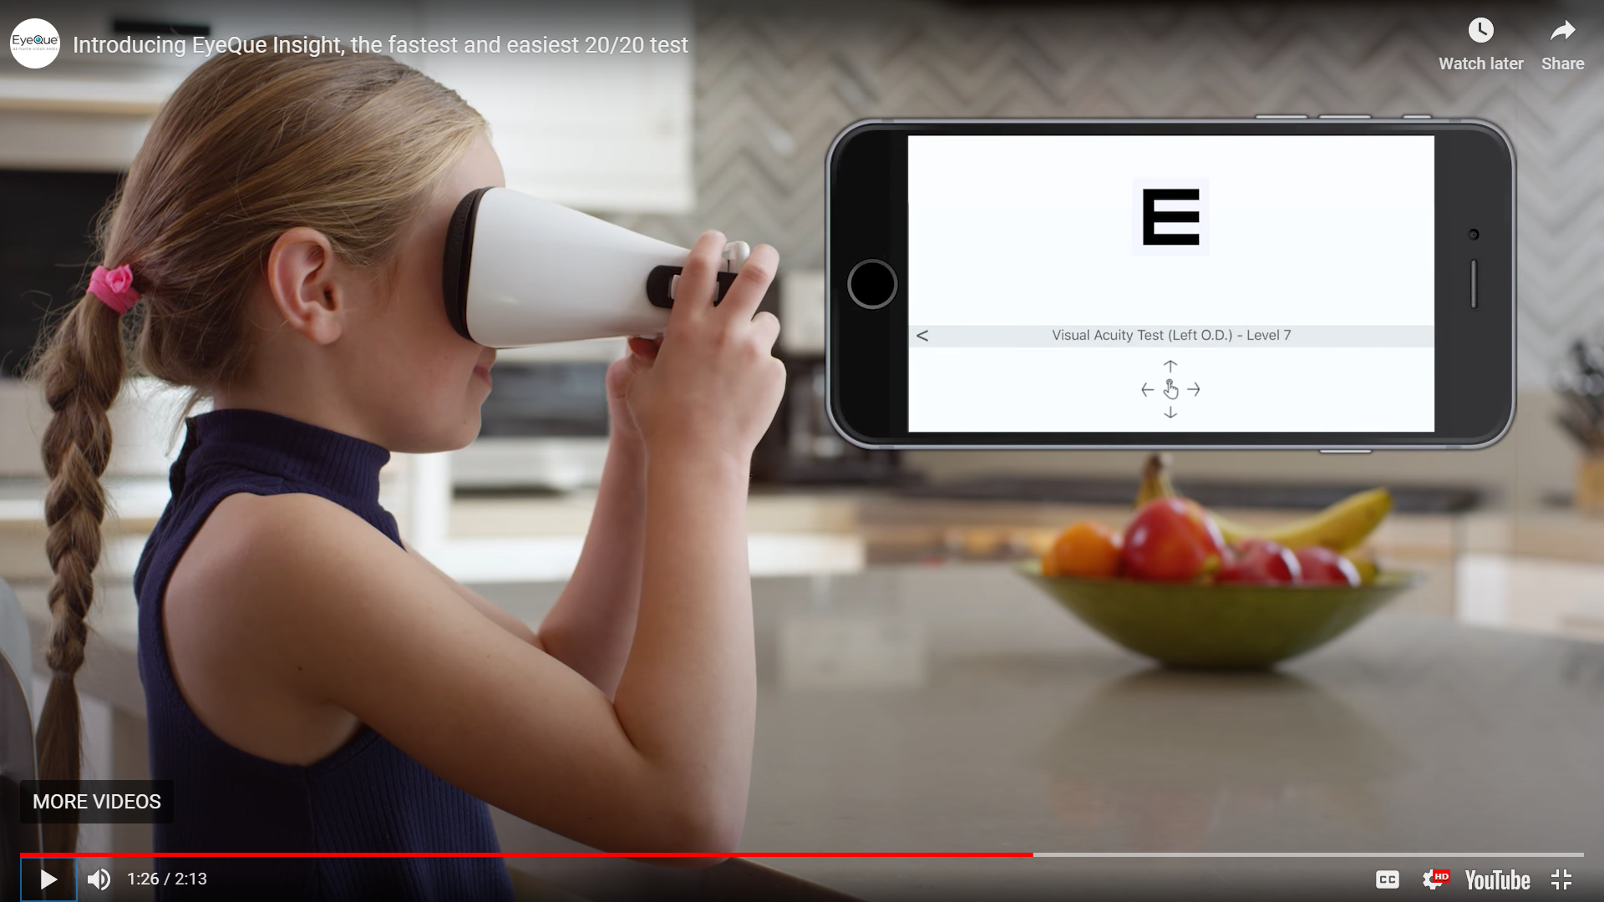

Slide 47
Does telehealth have a place in a myopia management practice?
Initial visit?
After a patient is treated?
Reinforce compliance with established patients (CL’s and gtt’s)
Reassurance of safety for parents: https://core.uwaterloo.ca/covid-19/
I&R?

Slide 48
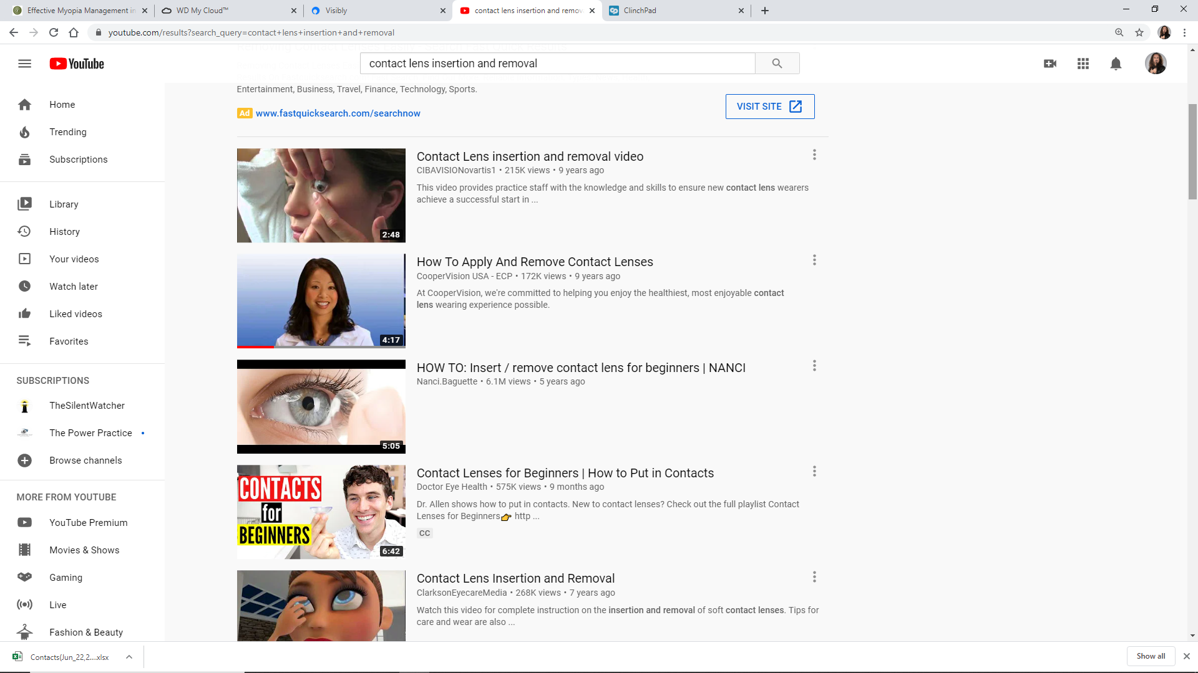
Youtube I&R search page

Slide 49
Patient (Parent) marketing during COVID-19
Webinars!
Promote via email, website and social/digital channels
Example

Slide 50
COPE CE requirement
Email your name and OE tracker number to:
Mariam.Muradi@TreehouseEyes.com
Interested in growing with us:
  Grow@TreehouseEyes.com

