Slide 1
We think big for little eyes.

Slide 2

Myopia: Why it really matters
Dr. Your Name
(any sponsors?)_____________________ has supported this event with an unrestricted educational grant

Slide 3
Treehouse Eyes Team: World class clinical and strategic team
  Co-founders:
Gary Gerber, OD
Matt Oerding, MBA
Clinical advisors:
Thomas Aller, OD
Patrick Caroline, COT
Jeffrey Cooper, MS, OD
Earl Smith, OD, PhD, Dean
Erin Stahl, MD
Vance Thompson, MD
Strategic advisors:
Dean Butler
Don Fox
  Optometrist, practice management consultant
  20+ years experience in leadership and marketing
  Awarded one of the first patents for myopia management
  Leading authority on use of GP lenses for myopia management
  Leading authority on atropine use for myopia management
  World leading myopia treatment researcher, Dean UHCO
  Pediatric ophthalmologist and associate professor
  Internationally renowned researcher and refractive surgeon
  Founder of LensCrafters and Vision Express (UK)
  CEO, Firehouse Subs

Slide 4

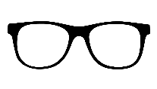
Myopia (nearsightedness) is an epidemic
25
%
700
yrs

Slide 5
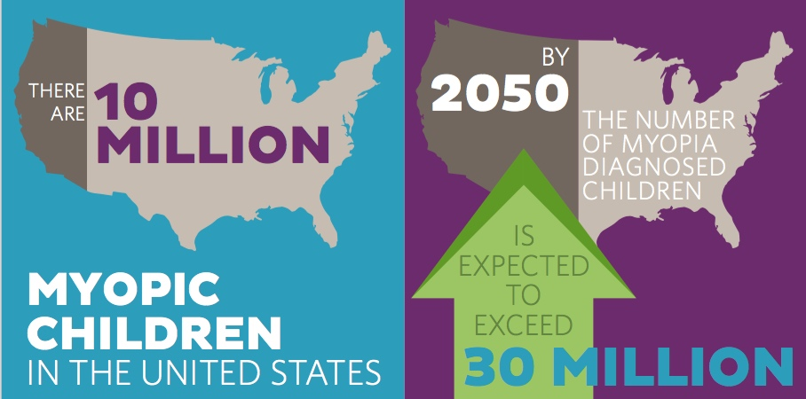

Slide 6
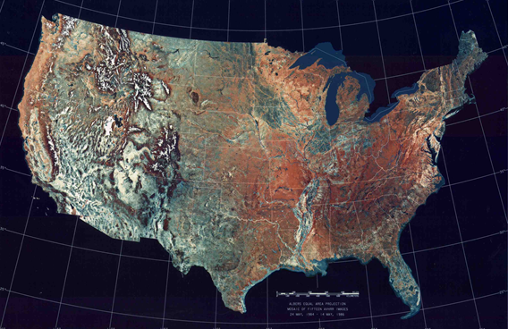
Increased Prevalence of Myopia in the US Between 1971-1972 and 1999 -2004
Susan Vitale PhD, Robert Sperduto MD, Frederick Ferris MD
Archives of Ophthalmology Vol. 127 No. 12 December 2009
Ages 12 -54
1971-1972 1999-2004
25.0% 41.6%
Myopic Myopic Myopic
A 66% increase in myopia in only 30 years!

Slide 7
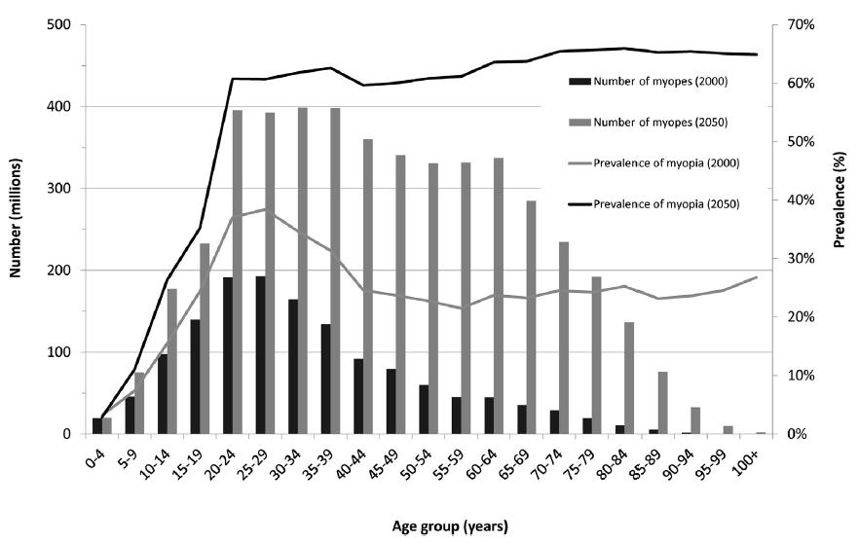
Distribution of People Estimated to have Myopia 2000 and 2050
Holden et al Ophthalmology 2016

Slide 8
“Myopia is twice as big of a problem as obesity”
BCLA May 2015
Ian Flitcroft MA DPHIL FRCOPHTH

Slide 9
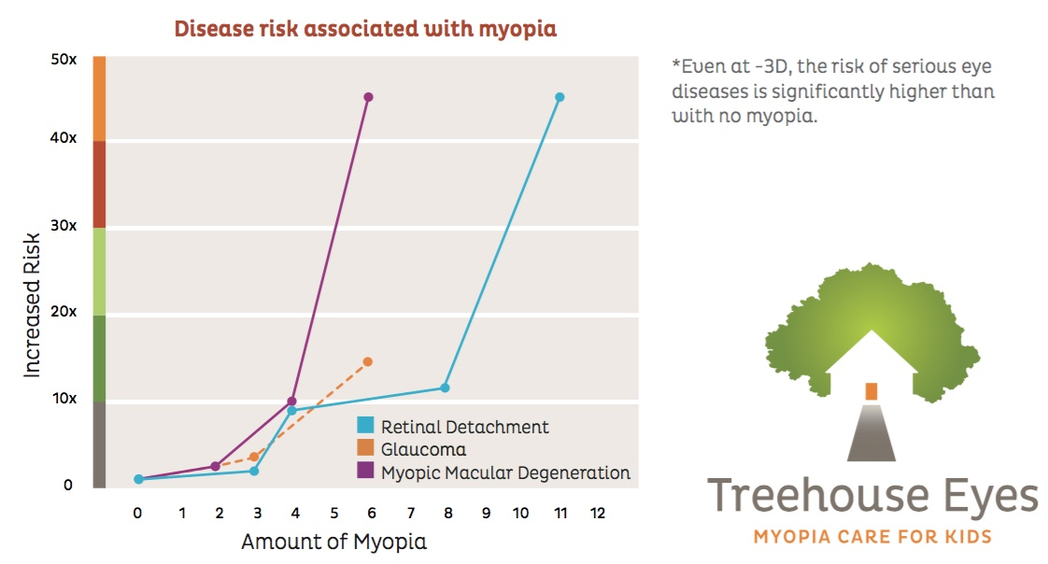
Problem: Myopia starts in children and progresses
Higher myopia proven to increase sight threatening disease risk

Slide 10
“Myopic kids get worse.”
BCLA May 2015
Earl Smith, OD, FAAO, PhD

Slide 11
“Physiological myopia does not exist.
There is no safe level of myopia.”
BCLA May 2015
Ian Flitcroft MA DPHIL FRCOPHTH

Slide 12
What's causing all this myopia?
The Nature Argument
    Myopia in both parents = 35%
    Myopia in one parent = 25%
    No myopic parents = < 10%
    Females more myopic than males

Slide 13


What's causing all this myopia?
The Nurture Argument

Slide 14
Dr. Monica Jong - Brien Holden Vision Institute
FedOpto Medillian Columbia 2015
“70% of todays myopia is environmentally driven. 30% is genetic.”
Lack of outdoor time
Near demand (?)

Slide 15
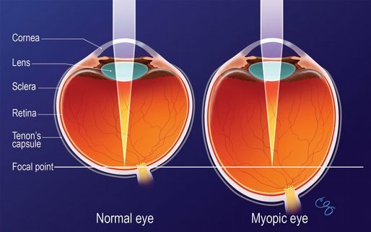
The underlying physiology of myopia

Slide 16
Is myopia a disease?
    “A disorder of structure or function in a human, animal, or plant, especially one that produces specific signs or symptoms or that affects a specific location and is not simply a direct result of physical injury.”
    If yes, then . . .
    If no, then . . .

Slide 17
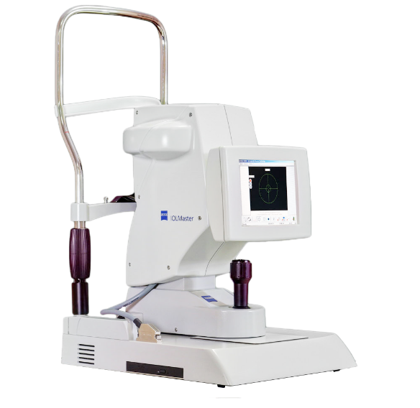
How do you know a myopic eye is too big?
    You measure it!
    Axial length vs. Diopters
    0.05 mm ~ 0.15 D

Slide 18
Why the increase in axial length?
In all species, (including humans) the two eyes typically grow in a highly coordinated manner towards the ideal optical state, a process called _________________
The process is regulated by visual feedback.
Emmetropization.

Slide 19
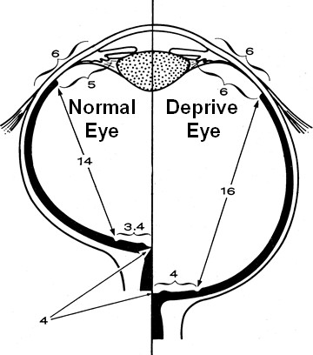
Chronic Image Degradation Causes Myopia
Wiesel & Raviola 1977

Slide 20
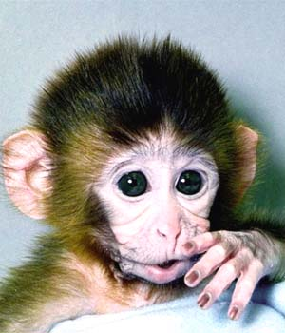
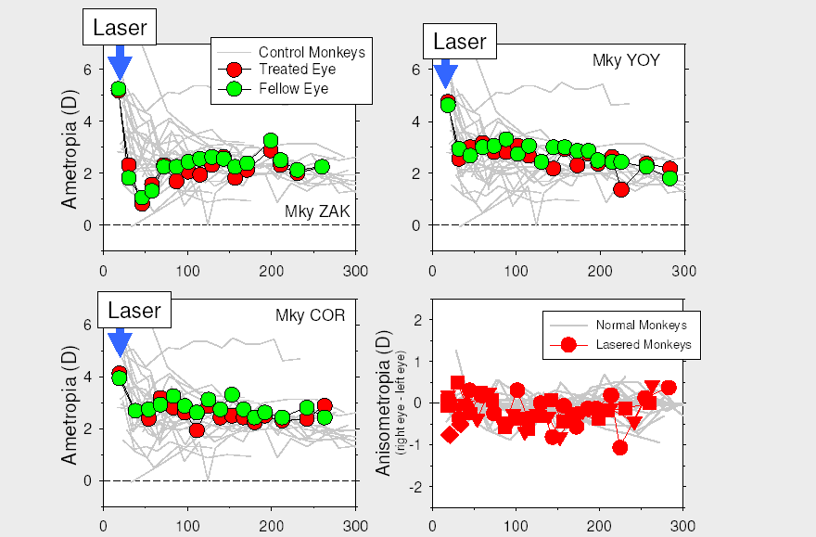
What part of the retina is responsible for normal emmetropization – fovea or periphery?

Slide 21
What part of the retina is responsible for normal emmetropization – fovea or periphery?
Conclusions:
A functioning fovea is NOT essential for normal axial length development
An intact periphery IS essential for normal axial length growth

Slide 22
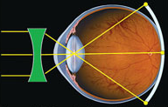
The problem with compensatory eyeglass lenses
Hyperopic Peripheral Defocus

Slide 23
At what Rx does myopia start?
    At last years’ visit, the 7 year old female was +1.50
    At todays’ visit, the 8 year old female is +0.25
    Parents are -8.50
    14 year old sister is -6.00
    Is the patient myopic?
      What if axial length was 23.00?
      What if axial length was 24.00?
      What if axial length was 26.00?

Slide 24
What is the “Two Phase” approach to treating myopia?

Slide 25
What is the “Two Phase” approach to treating glaucoma?
Phase 1
  CC
  Diagnose
  Prescribe to compensate (“correct”) for blurry vision
Phase 2
  Treat or refer to prevent further progression

Slide 26
What is the “Two Phase” approach to treating myopia?
Phase 1
  CC
  Diagnose
  Prescribe to compensate (“correct”) for blurry vision
Phase 2
  Treat or refer to prevent further progression

Slide 27
What is the difference in the CC between glaucoma and myopia?
Optically, not much
How we perceive and respond to the patient?

Slide 28


Tomorrow, one (or more) of the 10 million myopic kids in the US will walk into your practice.
Phase 1 – diagnose, identify, Rx
Phase 2 – treat or refer

Slide 29
Phase 2: Treatment

Slide 30
What does not work to slow down or stop myopia
        Perfect foveal correction with conventional eyeglasses
        Under-correcting
        Multifocal EGs (unless very high eso and acc lag – even then, minimal effect)
        On K RGPs
        CRT!

Slide 31
What does work
    Optical treatment
    Pharmaceutical treatment

Slide 32
What does work
% reduction in myopic progression
    Custom Soft Multifocal Lenses
    KIDS optics delivery system
    (Keratometric Induced Dioptric Steepening)
    3. Atropine
  Treehouse Vision System™
Optical Pharmaceutical
Source: Walline JJ, Greiner KL, McVey ME et al. OVS. 2013;90:1207‐14
Sankaridurg P, Holden B, Smith E, 3rd, et al. IVOS. 2011;52:9362‐7
Anstice NS, Phillips JR. Ophthalmol. 2011;118:1152‐61

Slide 33
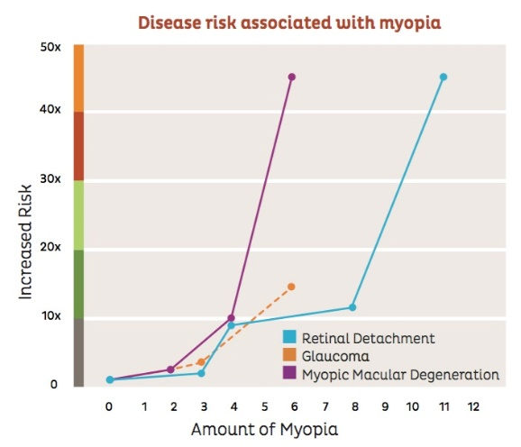
What does a 70% reduction in progression mean?
    Hx: 7 yo female, first eye exam is today
        Axial length is 23.58
        Rx is -1.00 OU
    Two Asian parents, both -9.00 OU
    12 year old brother, -4.75 OU
    Avid reader, 5 hours per day on digital devices
    Little outdoor time
    If expected Rx is -9.00 OU . . .
      70% reduction expect -3.40
      80% reduction expect -2.60
      85% reduction expect -2.20

Slide 34
What does a 70% reduction in progression mean?
    “Reducing a patient’s final level of myopia by ______ reduces the lifelong risk of myopic maculopathy by 40%, regardless of the final level of myopia.”
    - Mark Bullimore, OD, FAAO, PhD
1.00D

Slide 35
What does work to slow down or stop myopia
    Atropine
        Must be compounded
        Dosage based on Treehouse Vision System™
        Side Effects

Slide 36
What does work to slow down or stop myopia
    KIDS optics delivery system – overnight RGP
    Custom Soft Multifocal Contact Lenses – DW SCL
        High “add” essential
        High “add” means small OZ

Slide 37
The problem
Hyperopic Peripheral Defocus

Slide 38
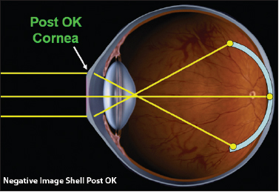
The solution – post Treehouse Vision System™

Slide 39
Why not use “off the shelf” CRT?

Slide 40
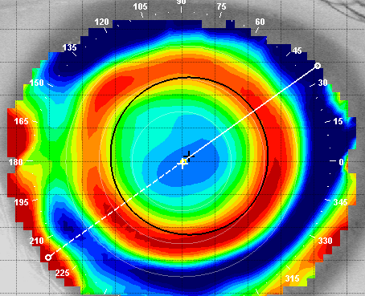
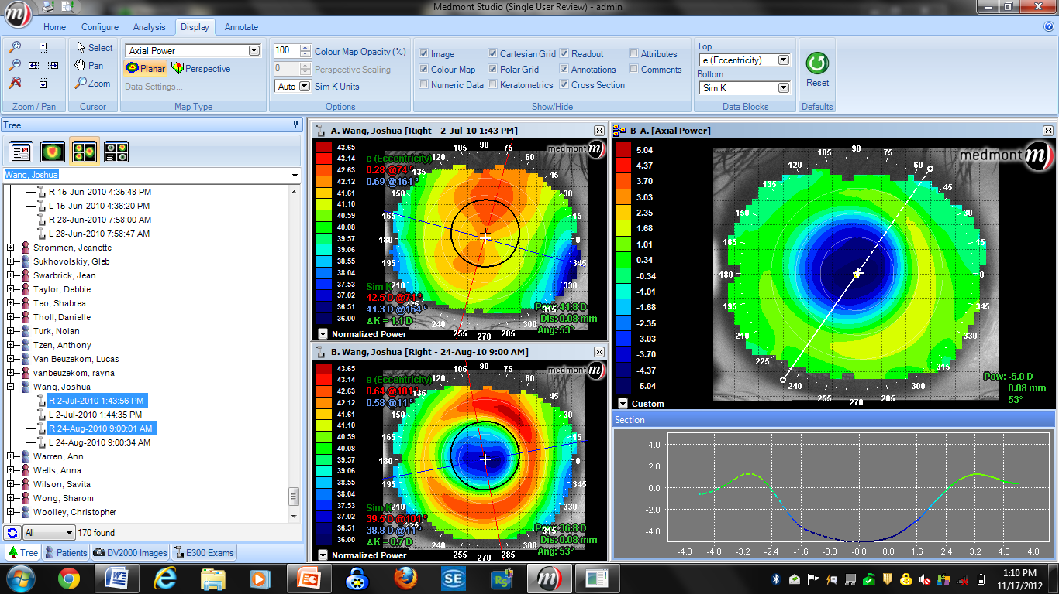
Rule #1
With KIDS,
the treatment zone is only
1 to 2 mm in diameter
Rule #2
The amount of plus power in the periphery equals at LEAST the amount of minus power corrected
5.0 mm
+4.00 D. +4.00 D..
-4.25 D.

Slide 41
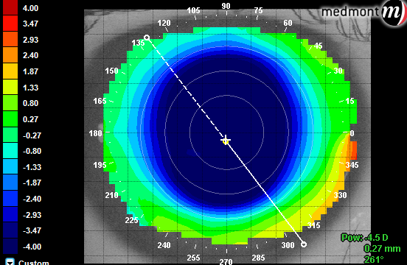
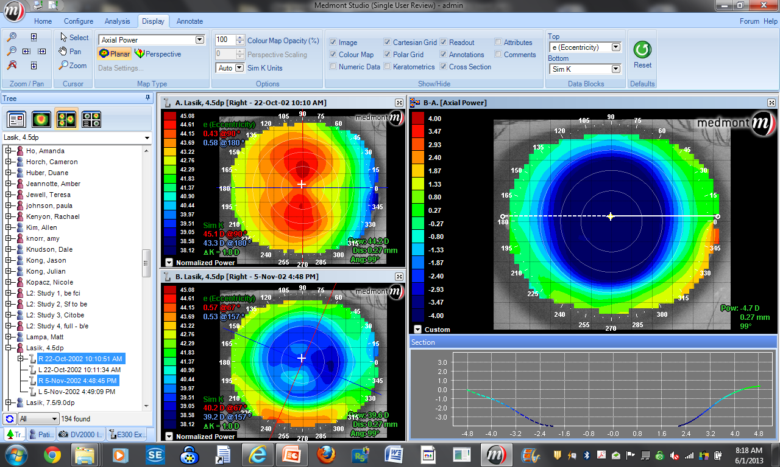
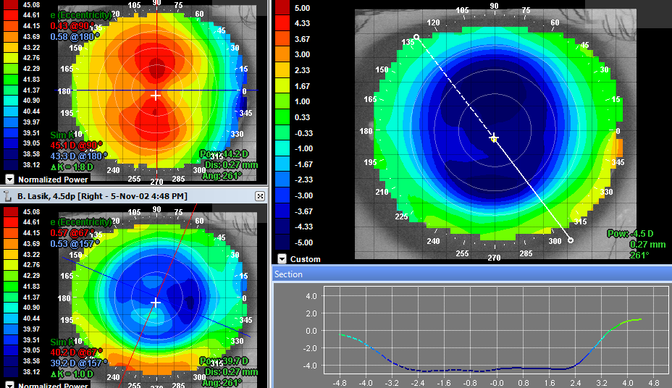
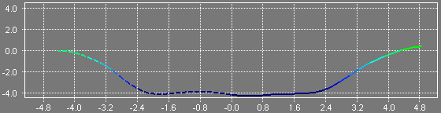
Post -4.75 LASIK
-4.75 D.

Slide 42
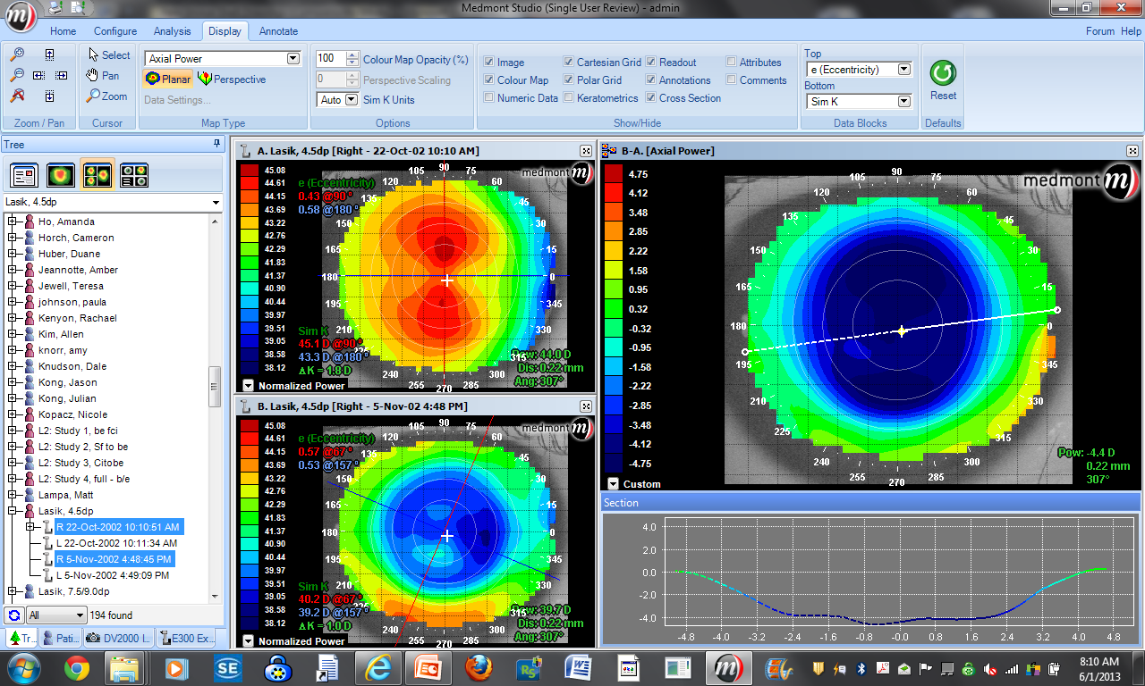
-4.75 D
5.0 mm Pupil

Slide 43
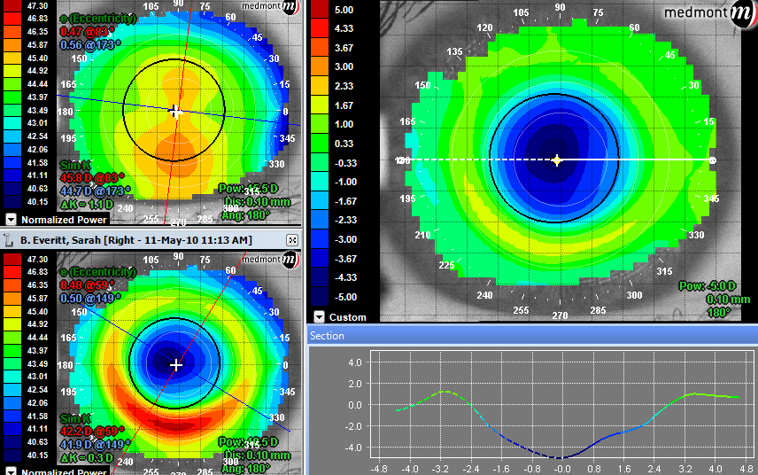
Post KIDS -5.00 D.

Slide 44

LASIK
5.0 mm Pupil
-4.75 D..
KIDS
5.0 mm Pupil
-5.00 D.

Slide 45
When you go back to your practice tomorrow, which myopic kid is a good candidate for myopia treatment?
    Less than 5 years old?
    Greater than 5 years old?
    Less than -1.00?
    Greater than -1.00?
    Some other criteria?

Slide 46
“Gary, it’s really easy. Tell doctors this:
Myopic kids get worse.
We’re not supposed to be myopic.”
VBD, 2017
Earl Smith, OD, FAAO, PhD

Slide 47
Tomorrow, one (or more) of the 10 million myopic kids in the US will walk into your practice.
What will you do in addition to compensatory minus lenses?

Slide 48
Remember . . .
Myopia treatment has TWO phases
Myopic kids get more myopic – so EVERY myopic kid is a candidate for treatment!
Stronger compensatory eyeglasses are part of the treatment, but not the solution to slowing myopia
YOU have the power and professional obligation to prevent future eye diseases in these kids!

Slide 49
Co-management with Treehouse Eyes

Slide 50
Myopia (nearsightedness) is an epidemic
10 million myopic kids already . . . and growing fast

Slide 51
Co-management with Treehouse Eyes
Who is a candidate?
Discussion with the parent

Slide 52
Your first two patients tomorrow
 | 1. Returning Presbyope | 2. Returning Myopic Kid
Chief Complaint | Working Distance too Long | Distance Vision Blurry
Findings
Case Presentation
a. Need to bump up Rx +0.25 OU
Need to bump up Rx -0.50 OU
b. Asymptomatic retinal tear
Myopia!
?
?

Slide 53
What NOT to say
 | 1. Returning Presbyope | 2. Myopic Kid
Chief Complaint | Working Distance | Distance Vision
Findings
Case Presentation
1. Need to bump up Rx +0.25 OU
1. Need to bump up Rx -0.50 OU
2. Asymptomatic retinal tear
2. Myopia!
?
?
“Suggestion”

Slide 54
What NOT to say
 | 1. Returning Presbyope | 2. Myopic Kid
Chief Complaint | Working Distance | Distance Vision
Findings
Case Presentation
1. Need to bump up Rx +0.25 OU
1. Need to bump up Rx -0.50 OU
2. Asymptomatic retinal tear
2. Myopia!
?
?
“Option”

Slide 55
What NOT to say
 | 1. Returning Presbyope | 2. Myopic Kid
Chief Complaint | Working Distance | Distance Vision
Findings
Case Presentation
1. Need to bump up Rx +0.25 OU
1. Need to bump up Rx -0.50 OU
2. Asymptomatic retinal tear
2. Myopia!
?
?
“Might want to think about”

Slide 56
What you should say . . .
Refer!
 | Returning Presbyope | Myopic Kid
Chief Complaint | Working Distance | Distance Vision
Findings
Case Presentation
1. Need to bump up Rx +0.25 OU
1. Need to bump up Rx -0.50 OU
2. Asymptomatic retinal tear
2. Myopia!
?
?
Notes:
Talk about our research with DMD and ortho DMD – “referral” analogue – parents expectations

Slide 57
Co-management with Treehouse Eyes
Who is a candidate?
Discussion with the parent
Mechanics

Slide 58

Two phases to co-manage myopic children
Eye Examination
Eyeglasses
Referral to Treehouse Eyes
Treehouse Eyes Myopia Evaluation
Treatment
Child back at your office for ongoing care & eyeglasses
Rx, filled at your practice
Comprehensive Exam at your practice
Book appointment for the parent in your practice, or tell them Treehouse Eyes will call
Send form
Myopia findings sent back to your practice
If co-managing, child visits your practice for 6-month over-refraction and BVA.
Send form to Treehouse Eyes
Phase 1 - Your Practice
Phase 2 - Treehouse Eyes
There is no safe level of myopia!

Slide 59
Co-management with Treehouse Eyes – Mechanics
Year 2
Year 3
Examine
Treehouse Eyes
Examine
Treehouse Eyes
You
You

Slide 60
Tools to help you
In your office - 2
For patients - 3

Slide 61
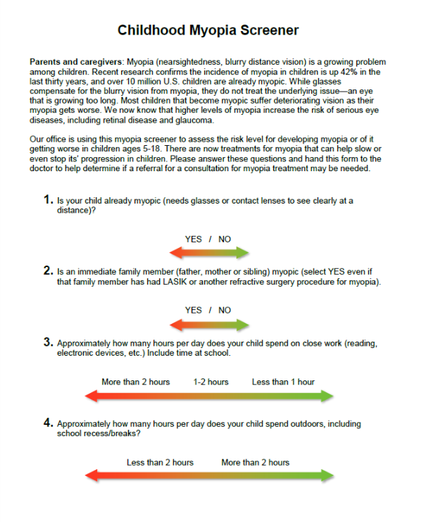
Tools to help you
In your office

Slide 62
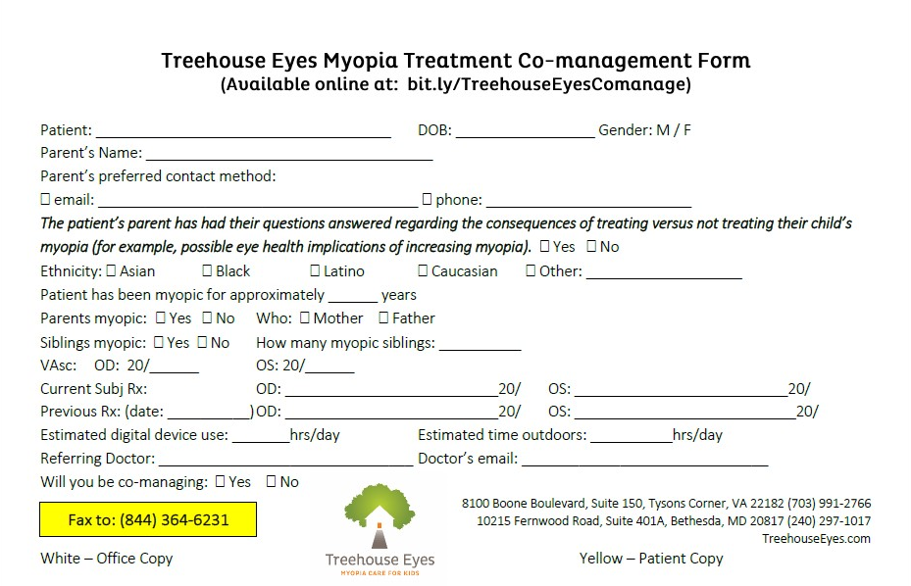
Tools to help you
In your office

Slide 63
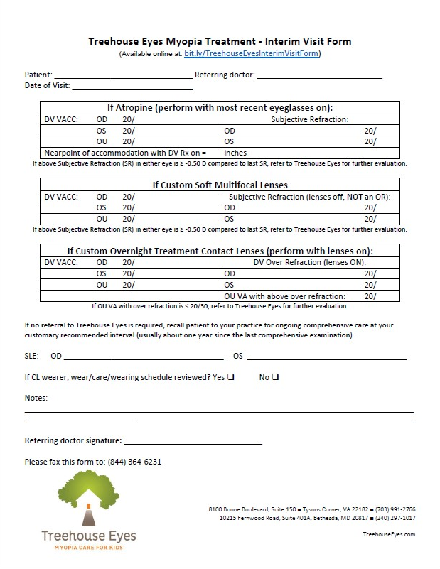
Tools to help you
In your office

Slide 64
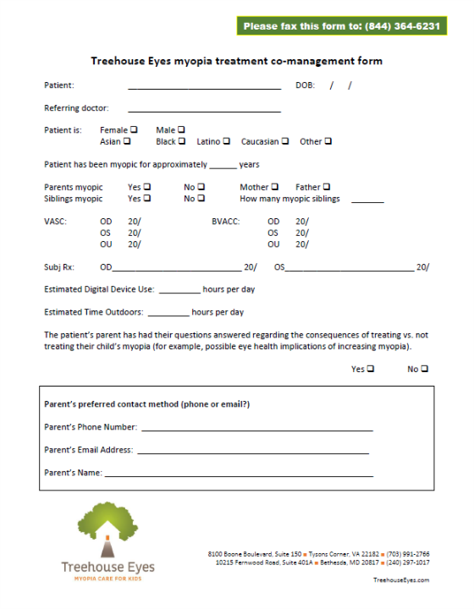
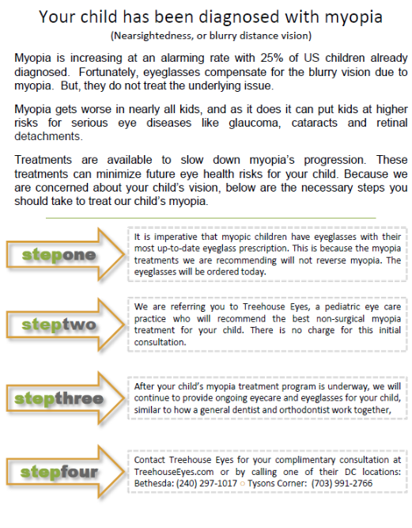
Tools to help you
For patients

Slide 65
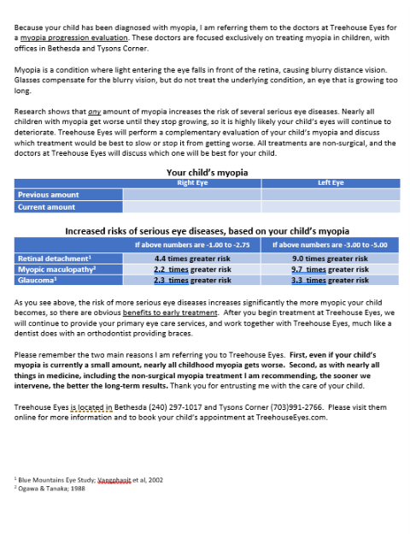
Tools to help you
For patients

Slide 66

Tools to help you
For patients

Slide 67
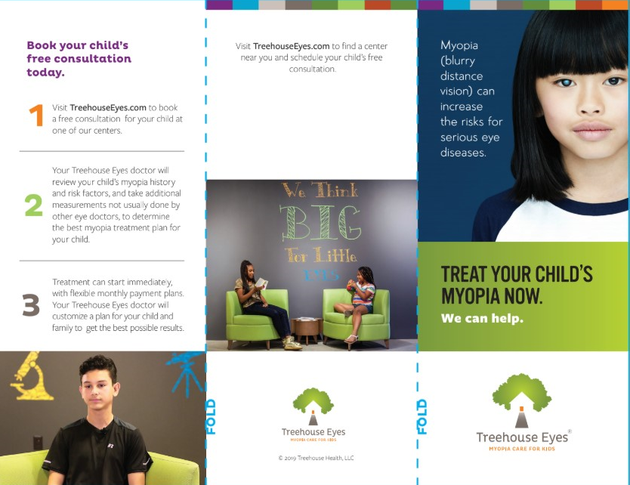
Tools to help you
For patients

Slide 68
Remember . . .
Myopia treatment has TWO phases
Myopic kids get more myopic – so EVERY myopic kid is a candidate for treatment!
Stronger compensatory eyeglasses are part of the treatment, but not the solution to slowing myopia
YOU have the power and professional obligation to prevent future eye diseases in these kids!

Slide 69
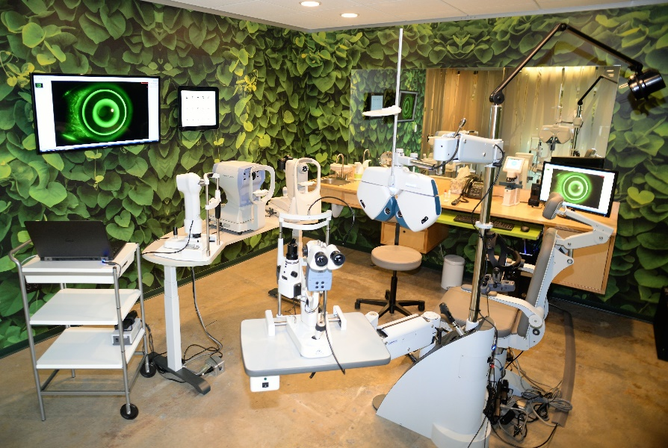

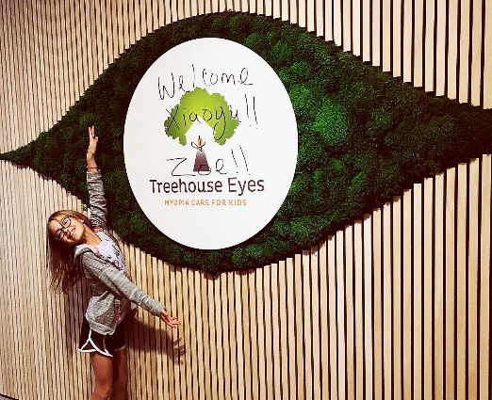

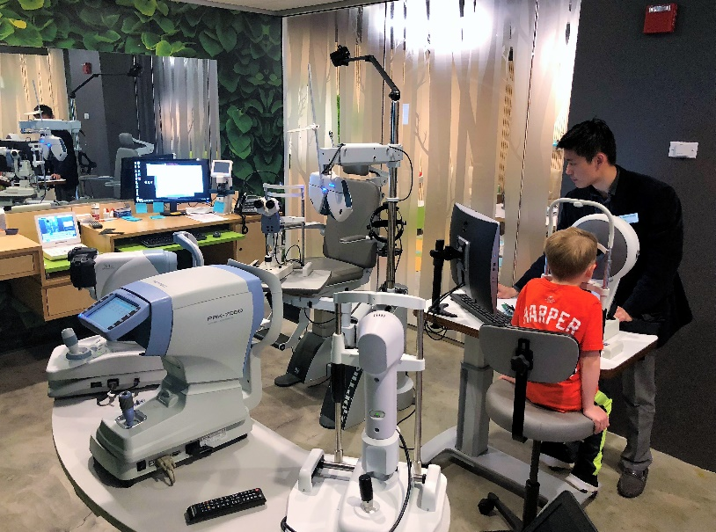
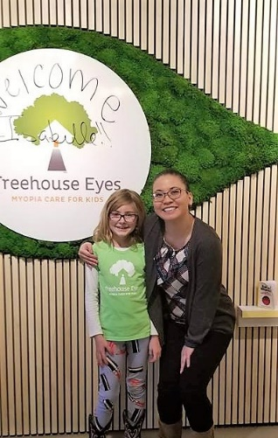
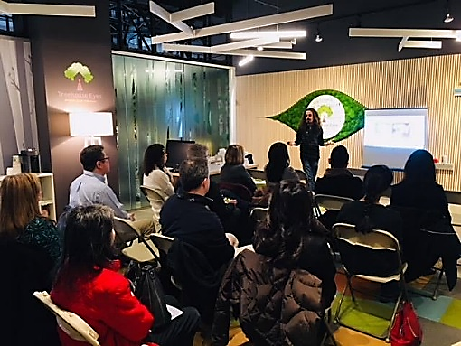


Slide 70
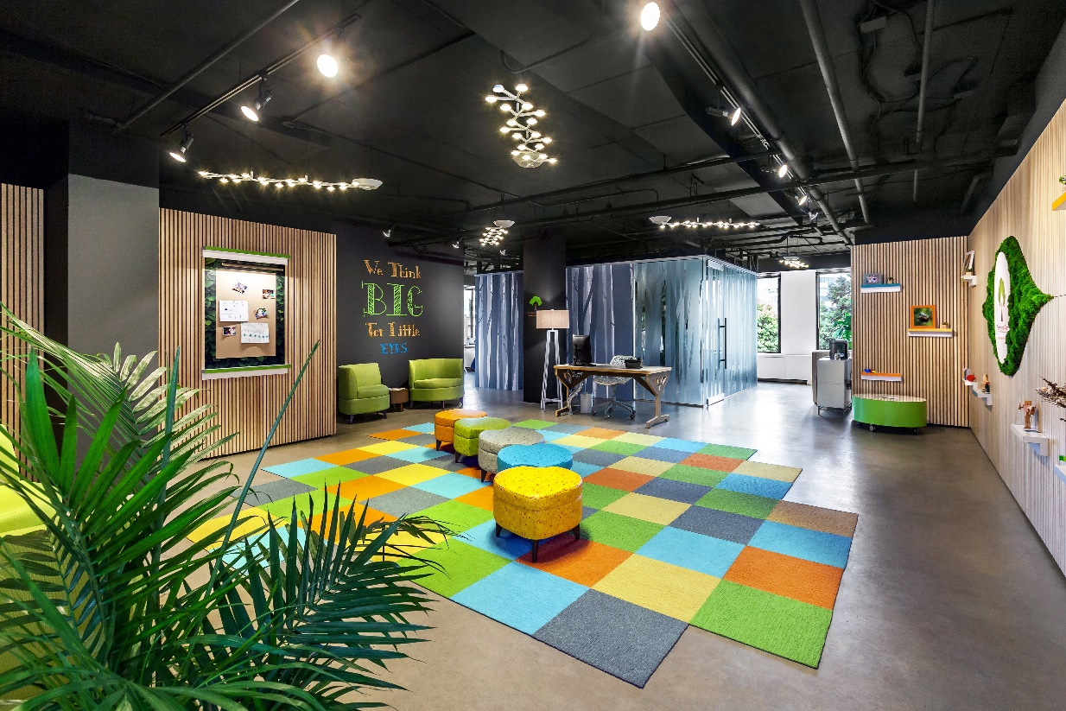

Please come visit us!
We think big for little eyes.

